Slide 1


Det 842 Wing Staff
Air Force ROTC Detachment 842
The University of Texas at San Antonio
C/Col Irizary
11 Jan 24

Slide 2


Overview
Wing Commander
Vice Wing Commander
Inspector General
Summary
Air Force ROTC Detachment 842 • We Build Exceptional Officers • The University of Texas at San Antonio

Slide 3
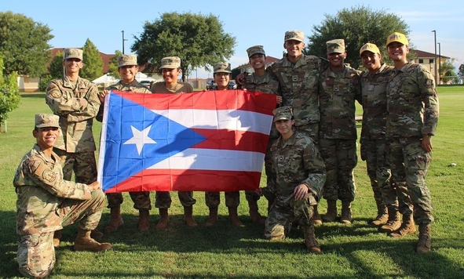
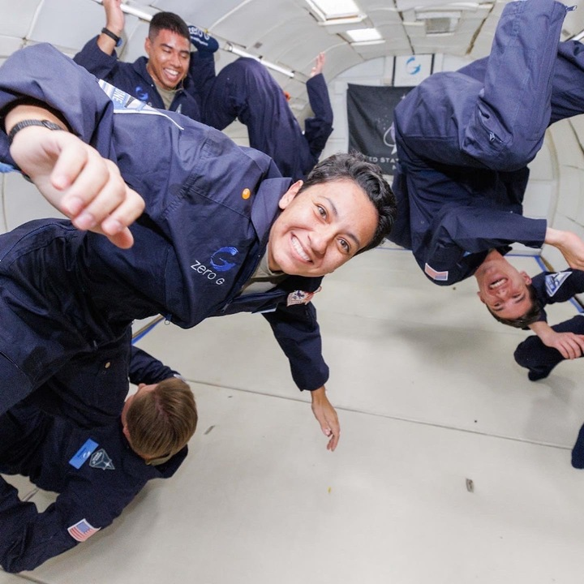
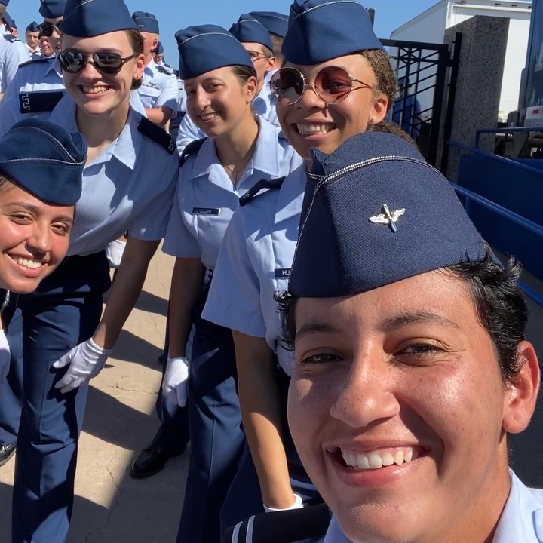
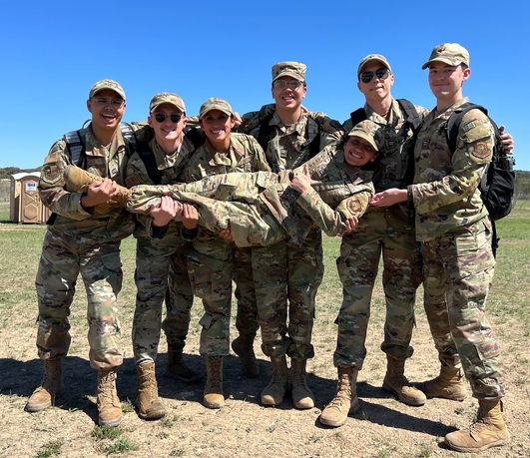
Wing Commander
C/Col Sophia Irizarry
Major: Cyber Security (BBA)
AFSC: 14N Intelligence
Experiences:
USAFA Cadet Exchange
Azimuth Space Force Program
Detachment Role:
Ensuring YOU have the proper training and support to succeed in AFROTC, school, and life.
Air Force ROTC Detachment 842 • We Build Exceptional Officers • The University of Texas at San Antonio
Notes:
Pictures can be added to the slide show.

Slide 4
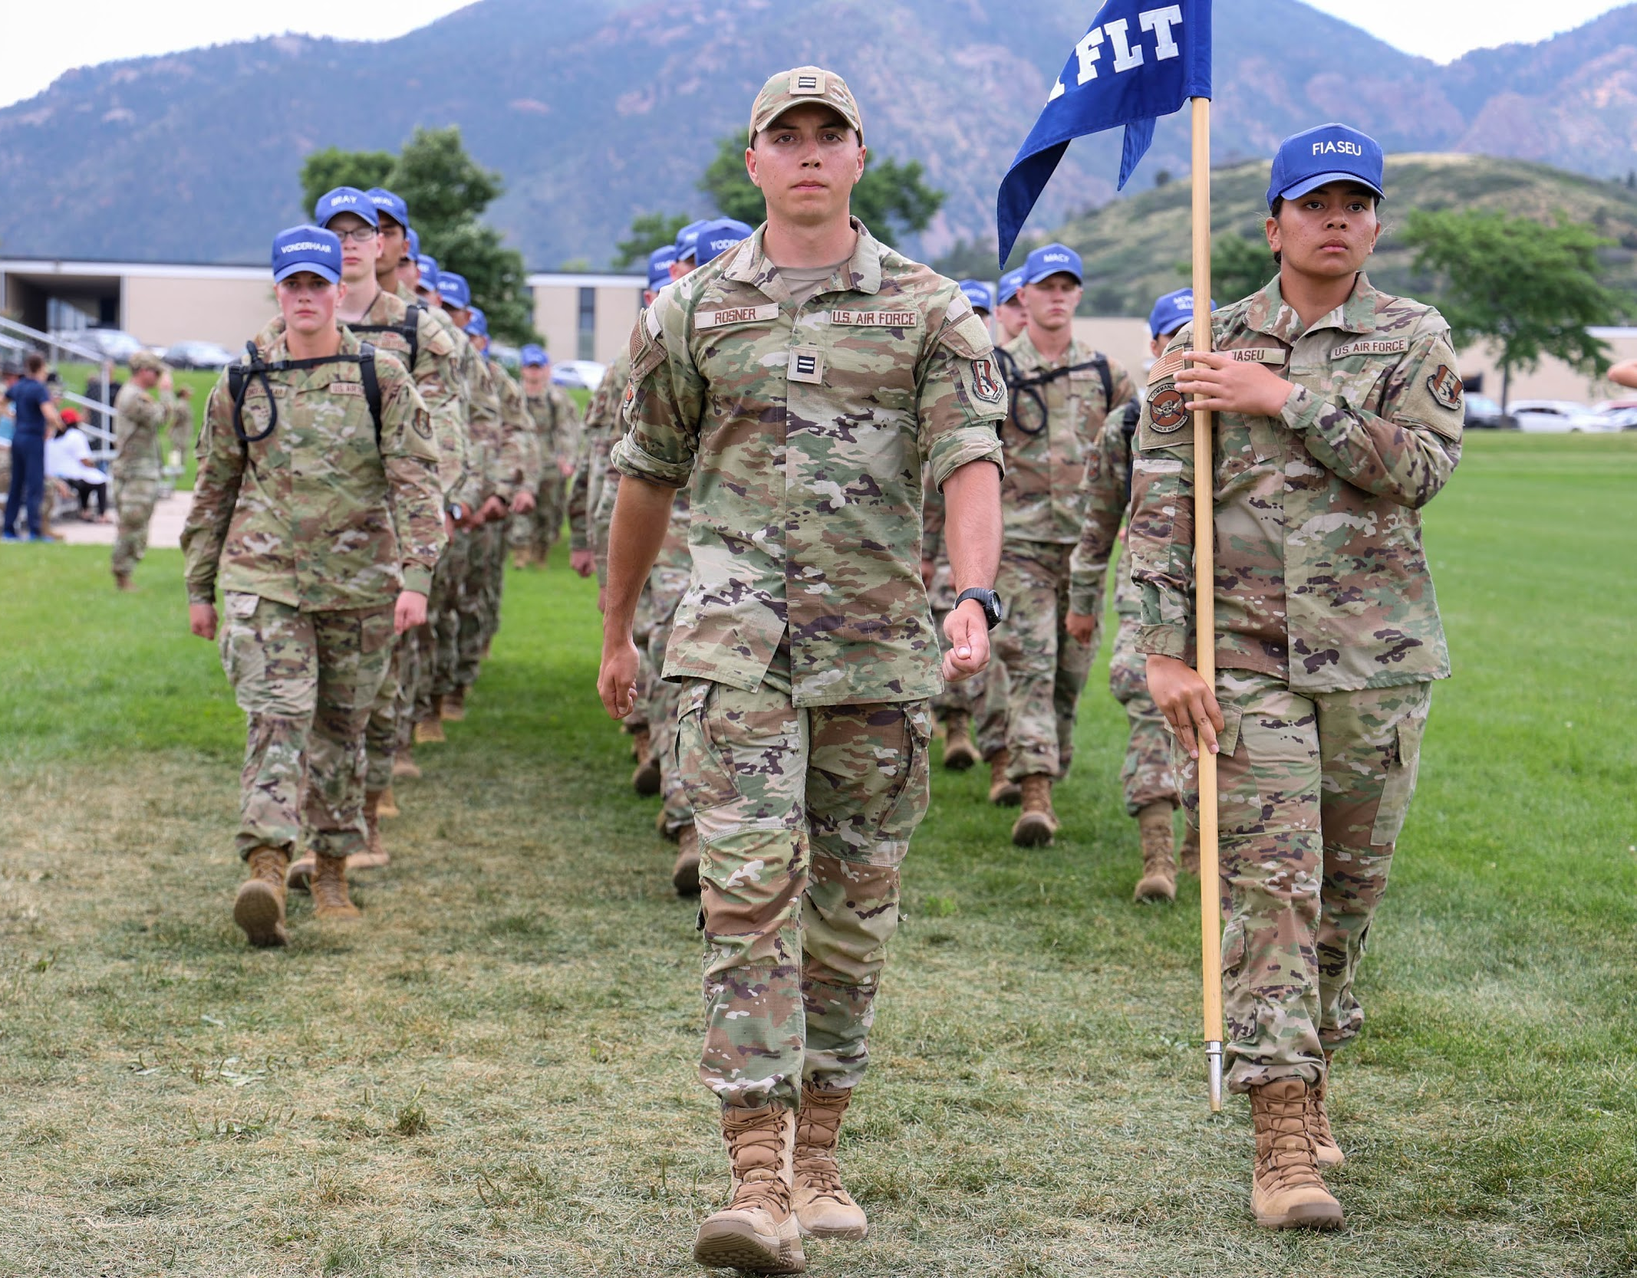
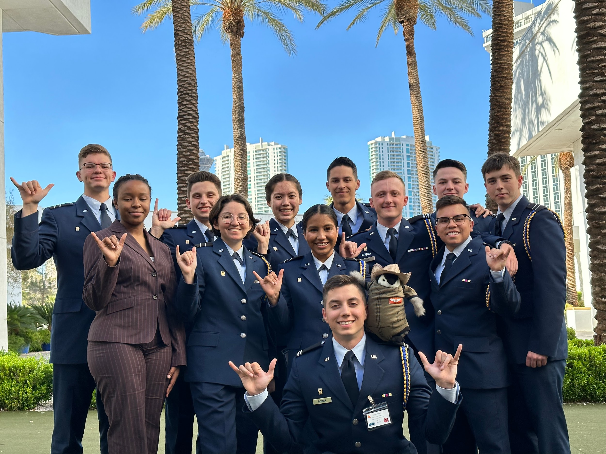
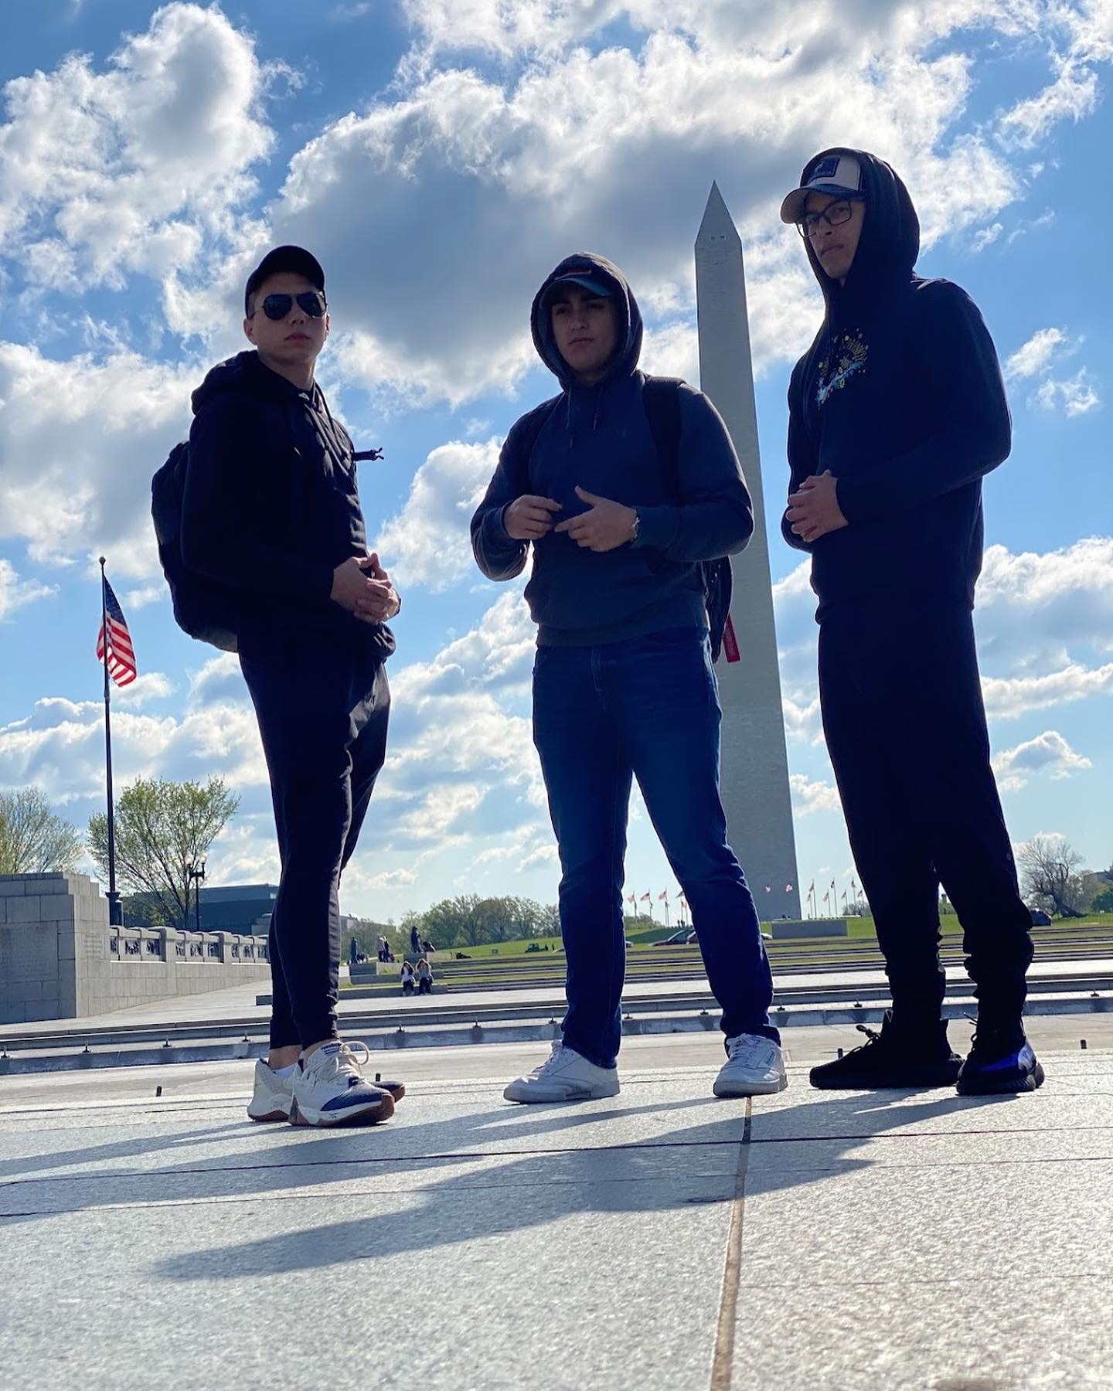
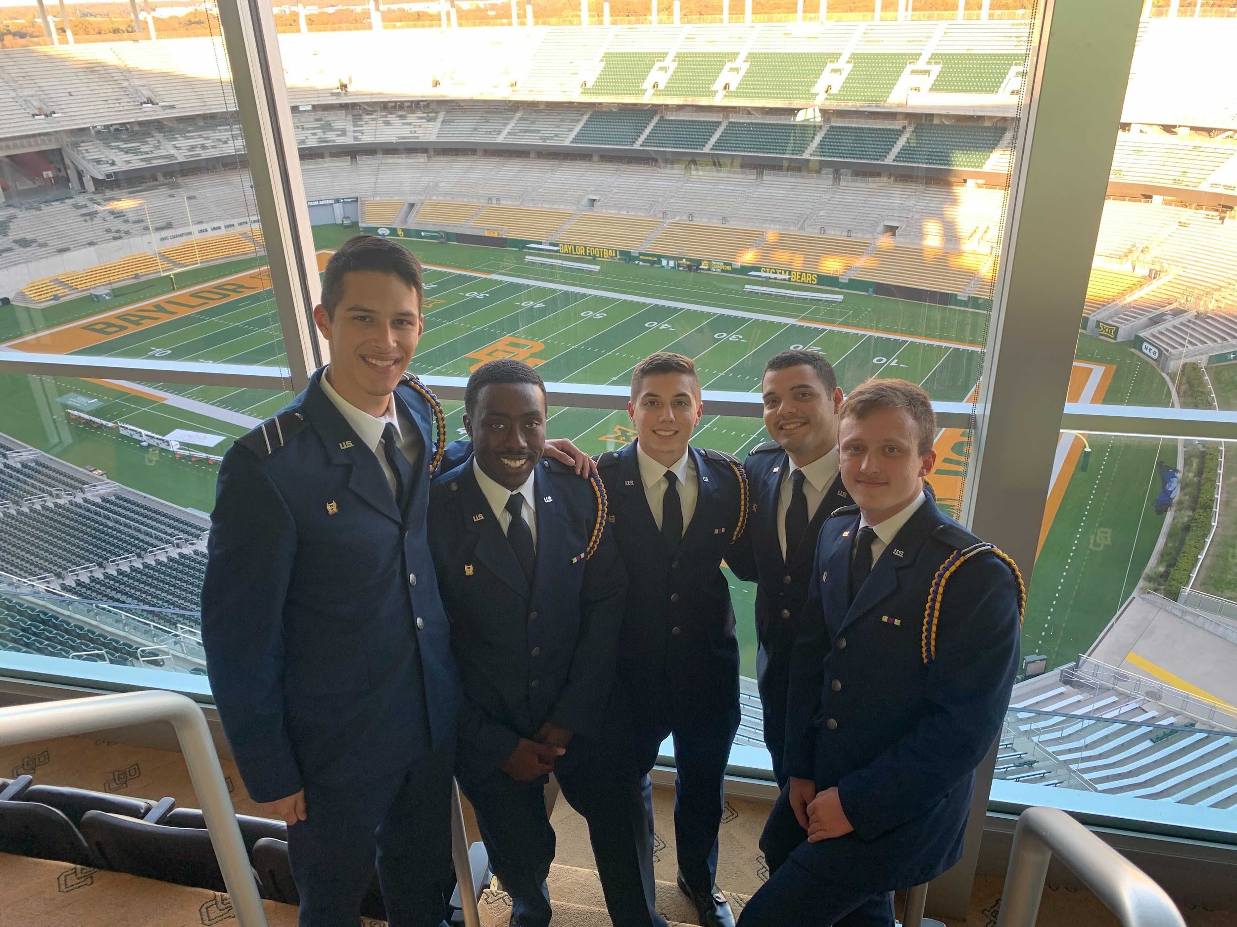
Vice Wing Commander
C/Col Joseph Rosner
Major: Computer Science
AFSC: Pilot (hopefully)
Experiences:
USAFA Prep School BMT CTA
AAS
Detachment Role:
Support and aid the Wing Commander in leading, mentoring, and overseeing the execution of detachment operations
Air Force ROTC Detachment 842 • We Build Exceptional Officers • The University of Texas at San Antonio
Notes:
Pictures can be added to the slide show.

Slide 5
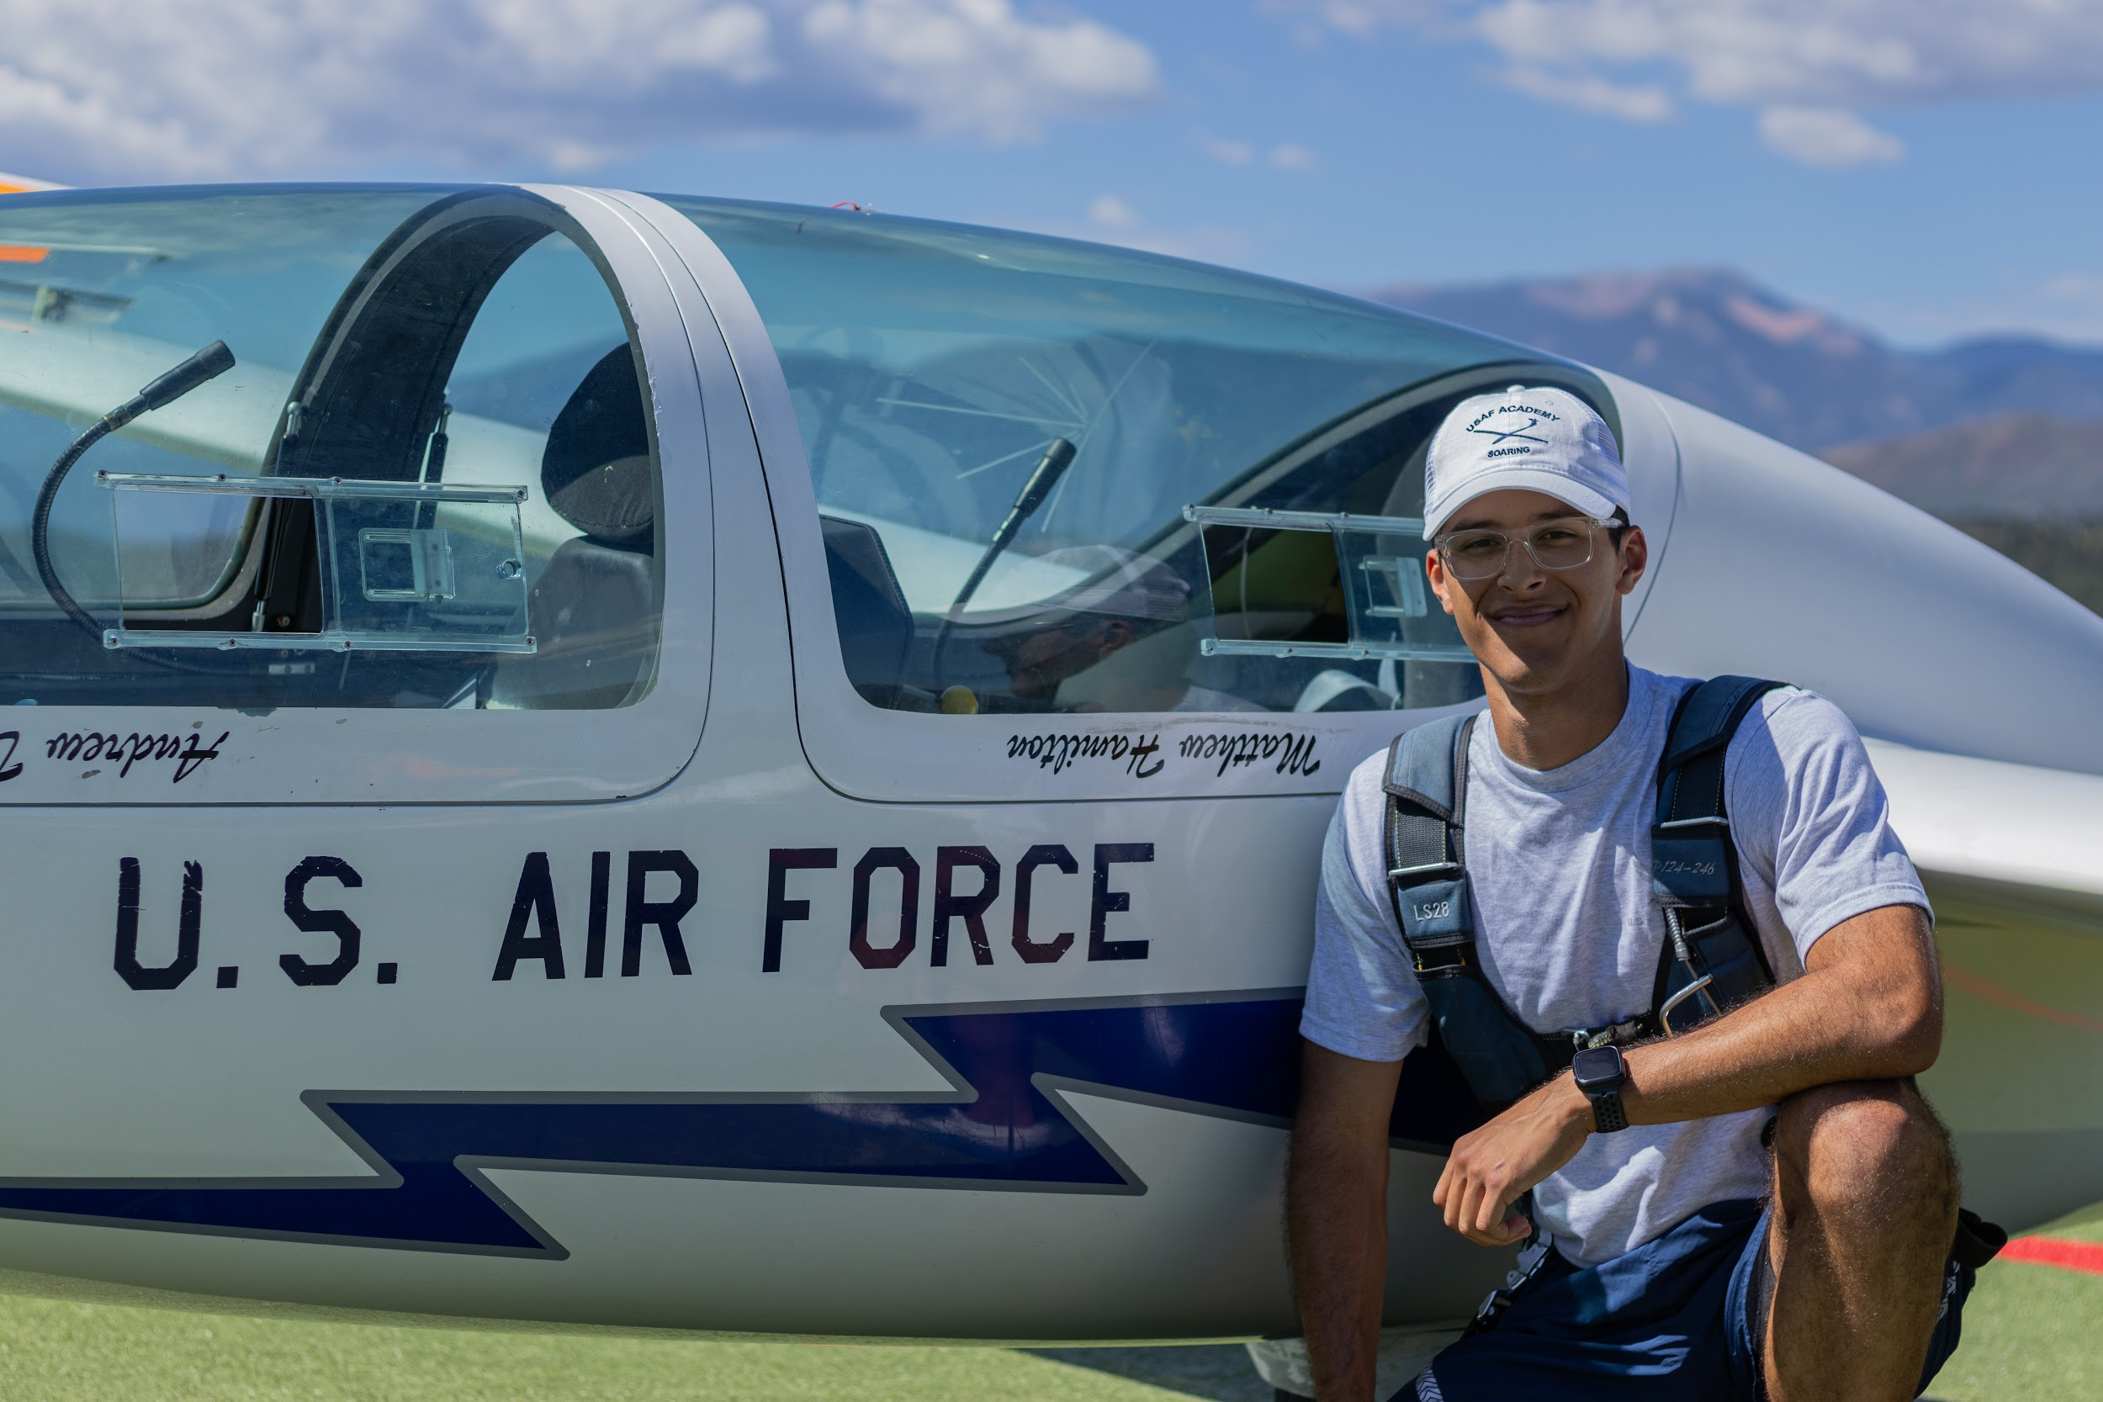
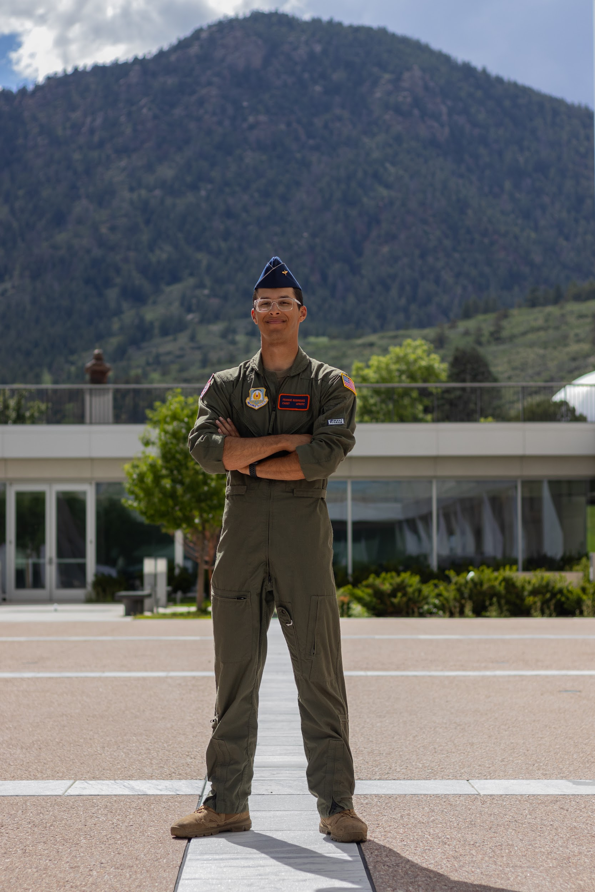
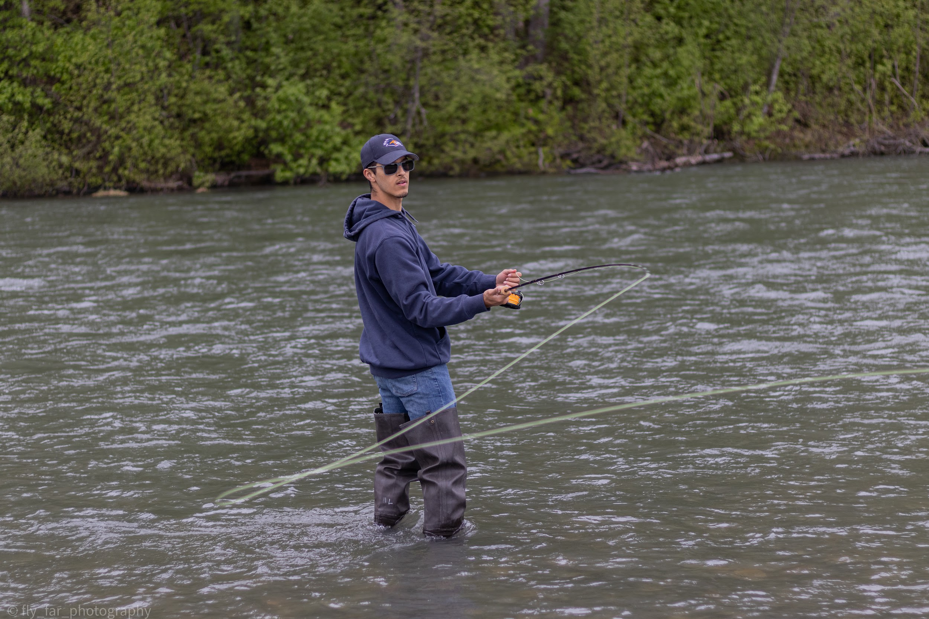
Inspector General
C/Lt Col Frankie Rodriguez
Major: Criminal Justice
AFSC: 11U - RPA
Experiences:
Military Brat
SOAR, You Can Fly
AAS
Detachment Role:
Ensure there is no mal-training, and bring any grievances cadets may have to A-Staff and Cadre.
Air Force ROTC Detachment 842 • We Build Exceptional Officers • The University of Texas at San Antonio
Notes:
Pictures can be added to the slide show.

Slide 6
Summary
Wing Commander
Vice Wing Commander
Inspector General
Summary
Air Force ROTC Detachment 842 • We Build Exceptional Officers • The University of Texas at San Antonio
Notes:
Should mirror the Overview

Slide 7
Questions?

Slide 8
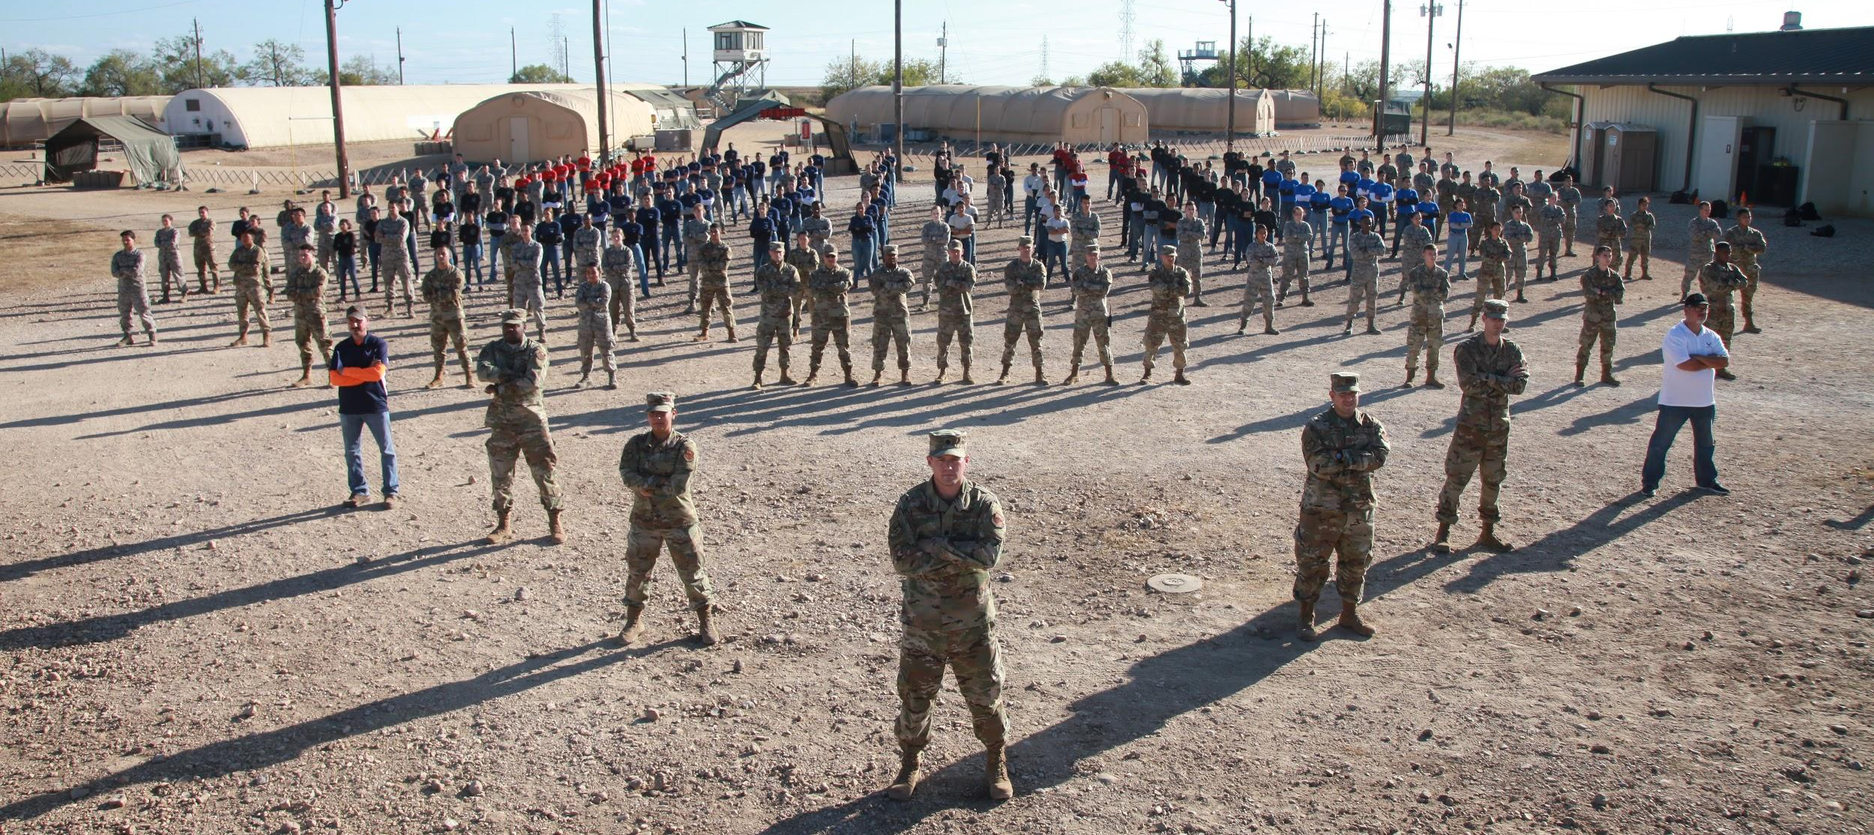
Air Force ROTC Detachment 842
The University of Texas at San Antonio
Det 842 – Best in Blue

Slide 9
Uniform Wear
Air Force ROTC Detachment 842
The University of Texas at San Antonio

Slide 10
Overview
References for Uniform Standards
Uniforms
Alternates
Alternate PT Uniforms
ROEs for Uniforms
Summary
Questions
Air Force ROTC Detachment 842 • We Build Exceptional Officers • The University of Texas at San Antonio

Slide 11
References for Uniform Standards

Slide 12
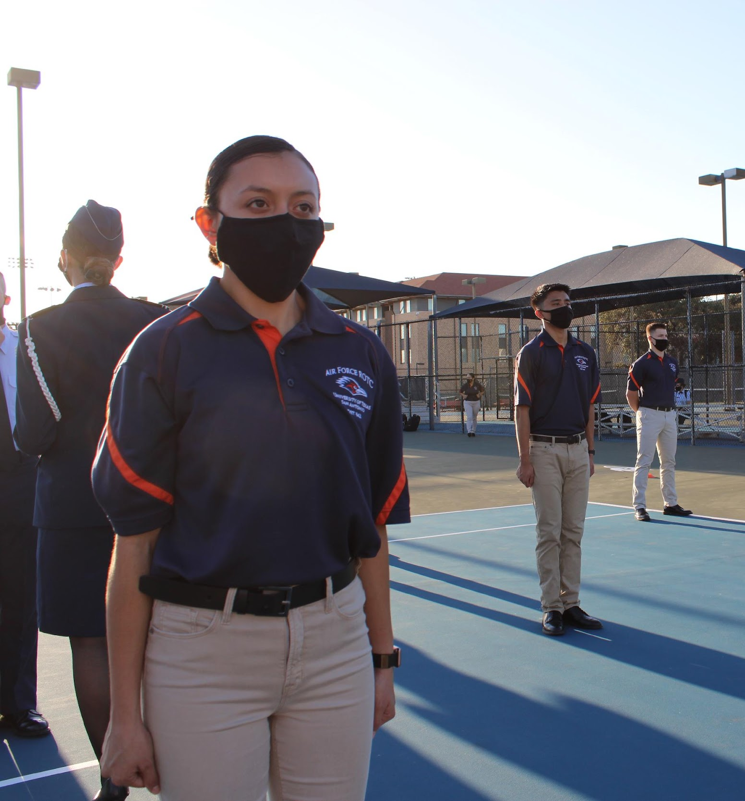
References for Uniform Standards
AFI 36-2903
AFI 36-2903 AFROTC Supplement
Cadet Handbook
Ask a Wingman
Air Force ROTC Detachment 842 • We Build Exceptional Officers • The University of Texas at San Antonio

Slide 13
Uniforms

Slide 14
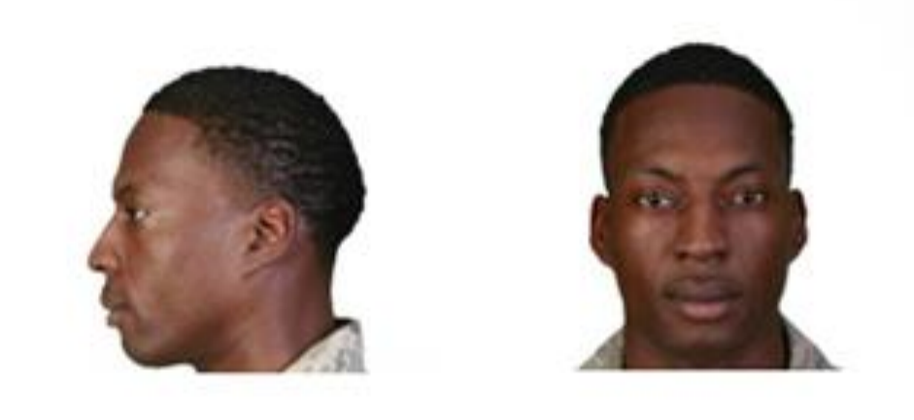
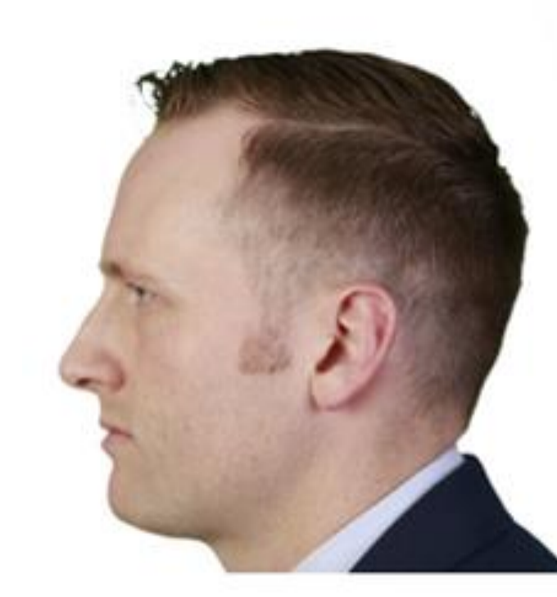
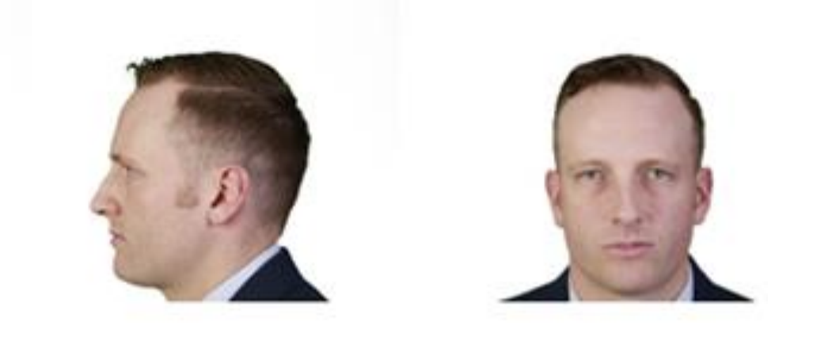
Male Hair Standards
Tapered appearance
Maximum 2 ½ inches in bulk
Only closely cut hair may touch the collar
Will not touch ears
Sideburns and mustache
Air Force ROTC Detachment 842 • We Build Exceptional Officers • The University of Texas at San Antonio

Slide 15
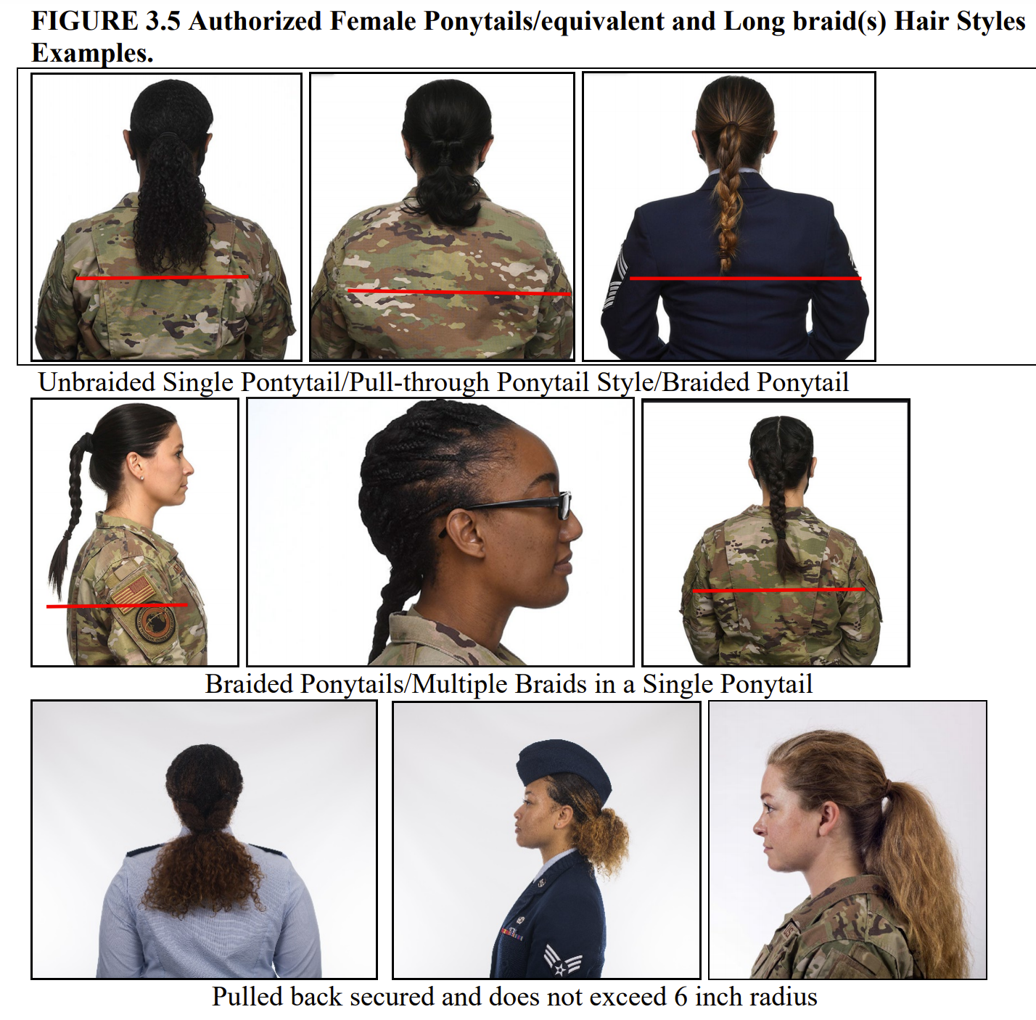
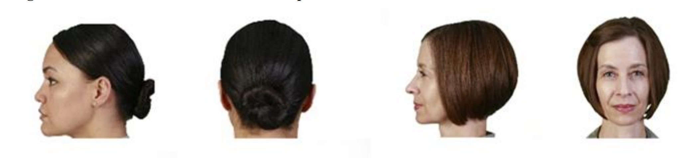
Female Hair Standards
No minimum length
Maximum 4 inches in bulk
Maximum 6 inch radius from gathering point
Short hair or bun must be above the collar
Bangs
Long braids and ponytails
Air Force ROTC Detachment 842 • We Build Exceptional Officers • The University of Texas at San Antonio

Slide 16
Jewelry
Earrings (females only)
Only one set in lobes
Restricted to round or square white diamond, gold, white pearl, or silver earrings
6mm in diameter
Rings
No more than 3
Wedding sets count as 1
AFI 36-2903 for more details
Air Force ROTC Detachment 842 • We Build Exceptional Officers • The University of Texas at San Antonio

Slide 17
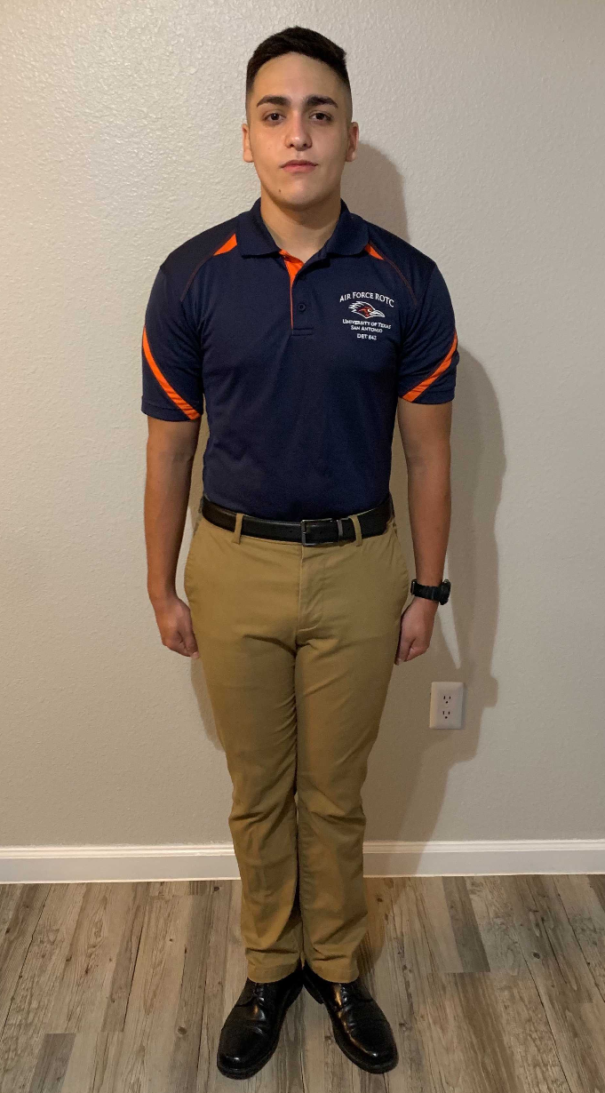
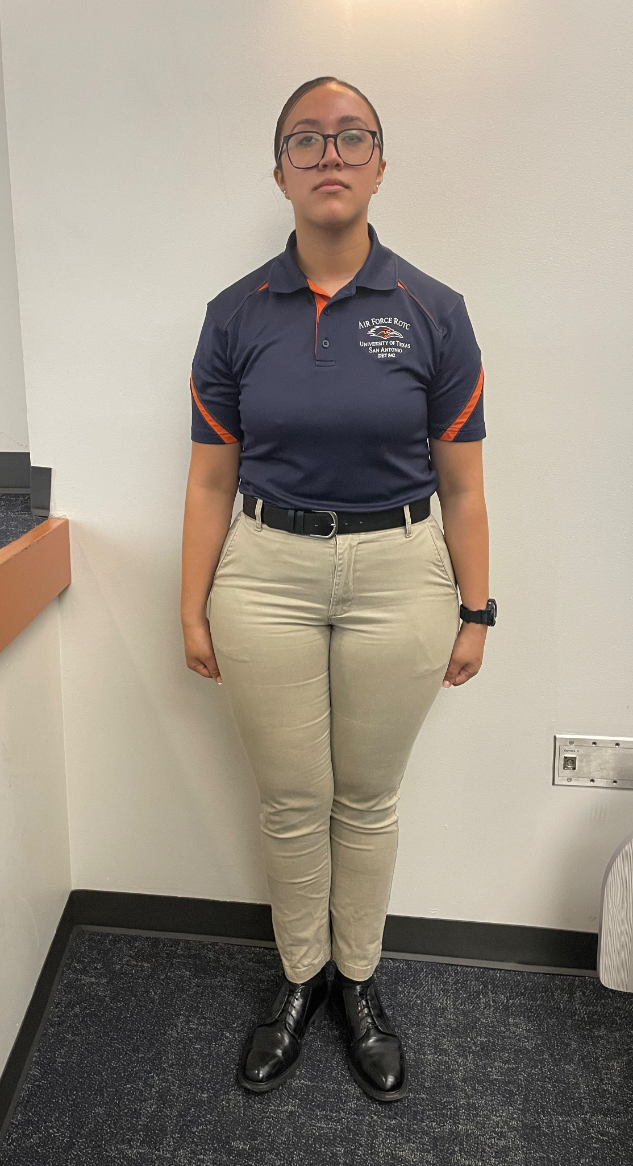
Alternate Uniform
Shirt
Pants
Black Belt
Black Watch
Air Force ROTC Detachment 842 • We Build Exceptional Officers • The University of Texas at San Antonio

Slide 18
Footwear
Black dress shoes
Black socks
Shoelaces tucked in
Air Force ROTC Detachment 842 • We Build Exceptional Officers • The University of Texas at San Antonio

Slide 19
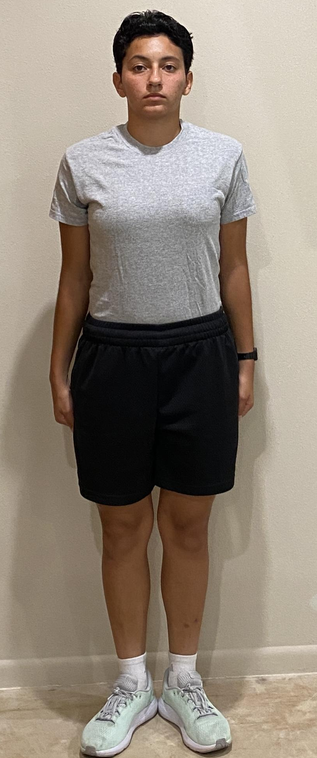
PT Alternates
Light Grey T-shirt
Black Shorts
Athletic Shoes (any color)
White Socks
Black Watch
Optional
Leggings
Long-sleeved Undershirt
Cold Weather
Black beanie and gloves
Black jacket or hoodie
Air Force ROTC Detachment 842 • We Build Exceptional Officers • The University of Texas at San Antonio

Slide 20
ROEs for Uniform Wear

Slide 21
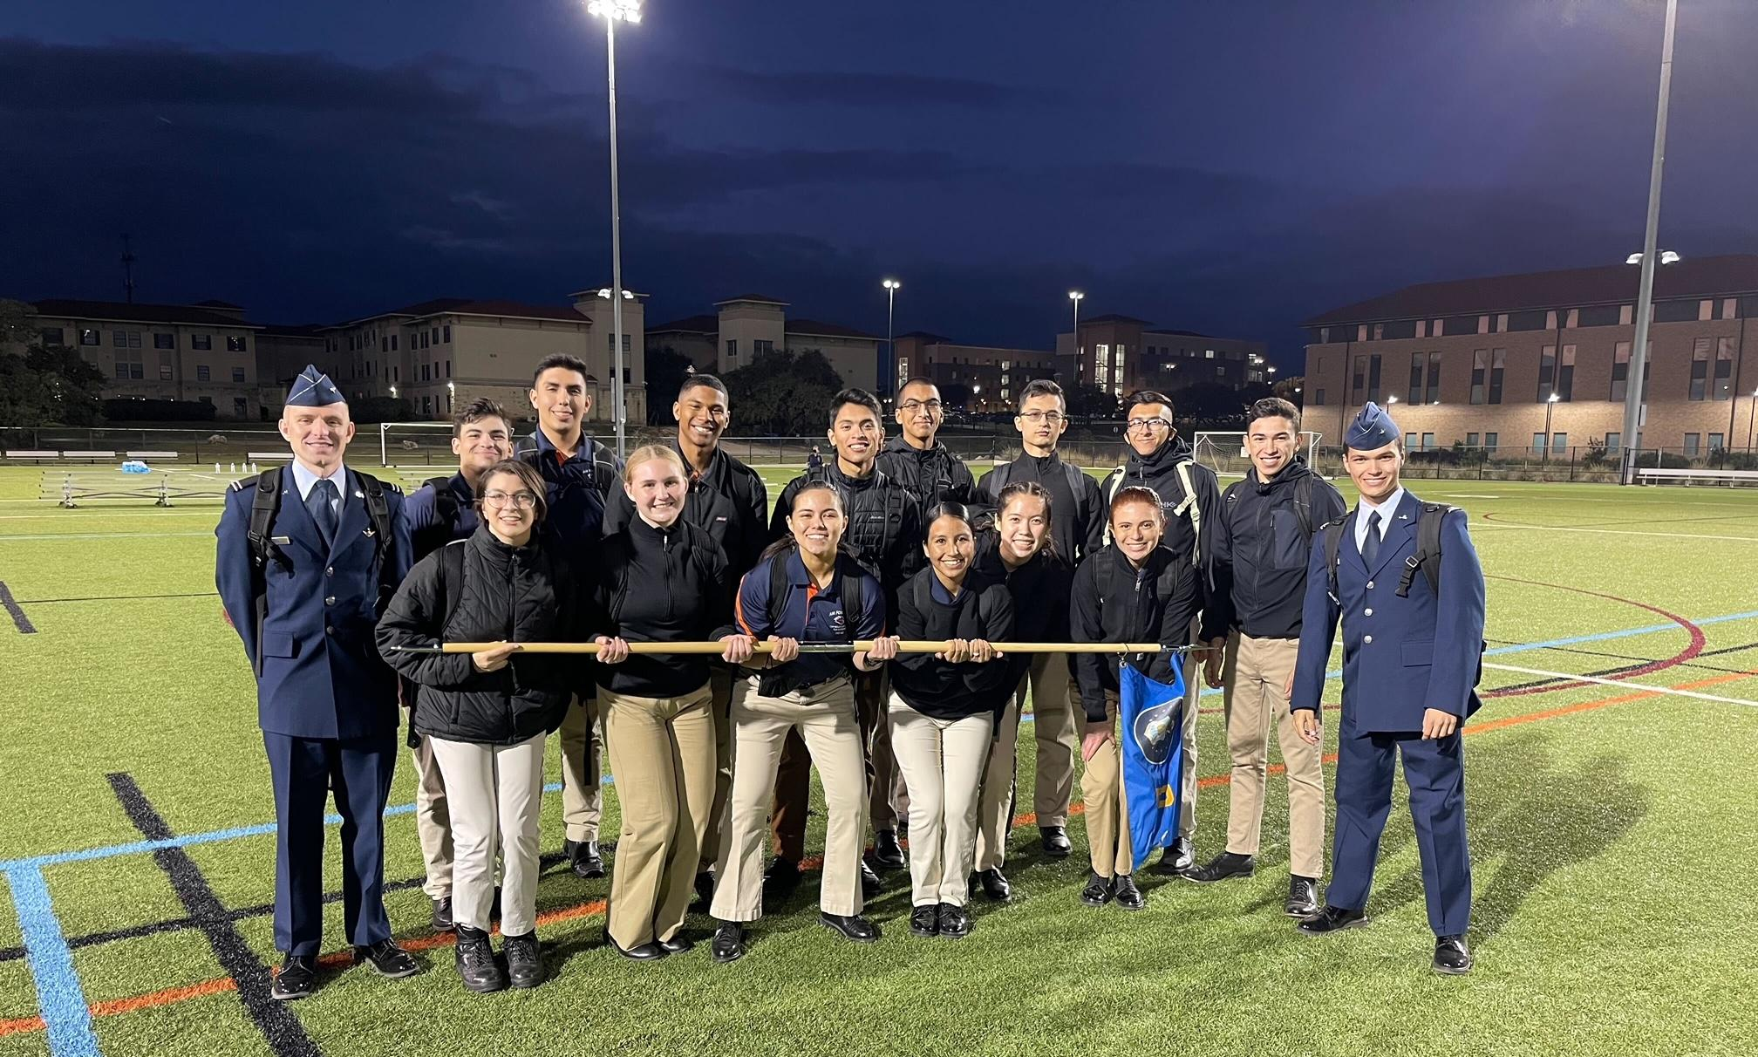
ROEs for Uniform Wear
Be Professional
If you have any questions, consult the Cadet Handbook or a POC
Air Force ROTC Detachment 842 • We Build Exceptional Officers • The University of Texas at San Antonio

Slide 22
Summary

Slide 23
Summary
References for Uniform Wear
Uniforms
Alternates
Alternate PT Uniforms
ROEs for Uniforms
Summary
Questions
Air Force ROTC Detachment 842 • We Build Exceptional Officers • The University of Texas at San Antonio

Slide 24
Questions?

Slide 25
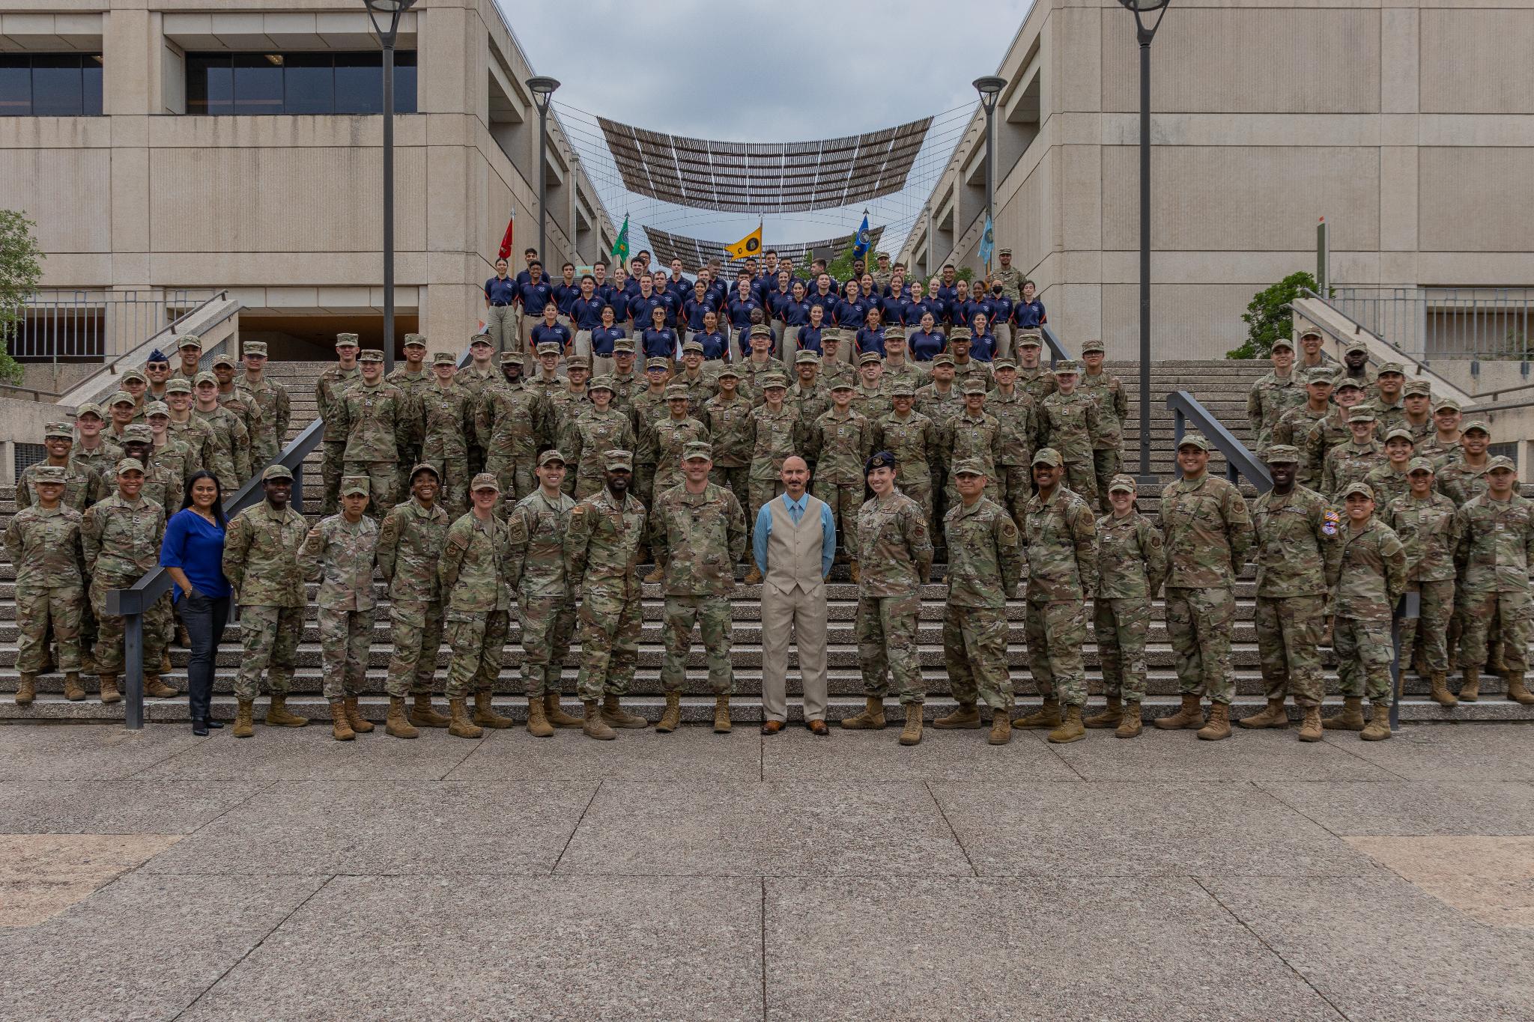
The University of Texas at San Antonio
Detachment 842

Slide 26
Det 842 Honor Guard
Air Force ROTC Detachment 842
The University of Texas at San Antonio
C/1stLt Fresquez
11 Jan 24

Slide 27
Overview
What HG Is
Expectations
Benefits
Practices
Summary
Air Force ROTC Detachment 842 • We Build Exceptional Officers • The University of Texas at San Antonio

Slide 28
What is Honor Guard?

Slide 29

What Is HG? What Do We Do?
Ensure the preservation of Air Force heritage through training, an adherence to standards, and a promotion of traditions
Represent the USAF & Detachment at public and official ceremonies
Represent all Airmen who have served and sacrificed for the United States—past, present, and future
Perform Honor Guard Drill & Ceremonies at many events
Air Force ROTC Detachment 842 • We Build Exceptional Officers • The University of Texas at San Antonio

Slide 30
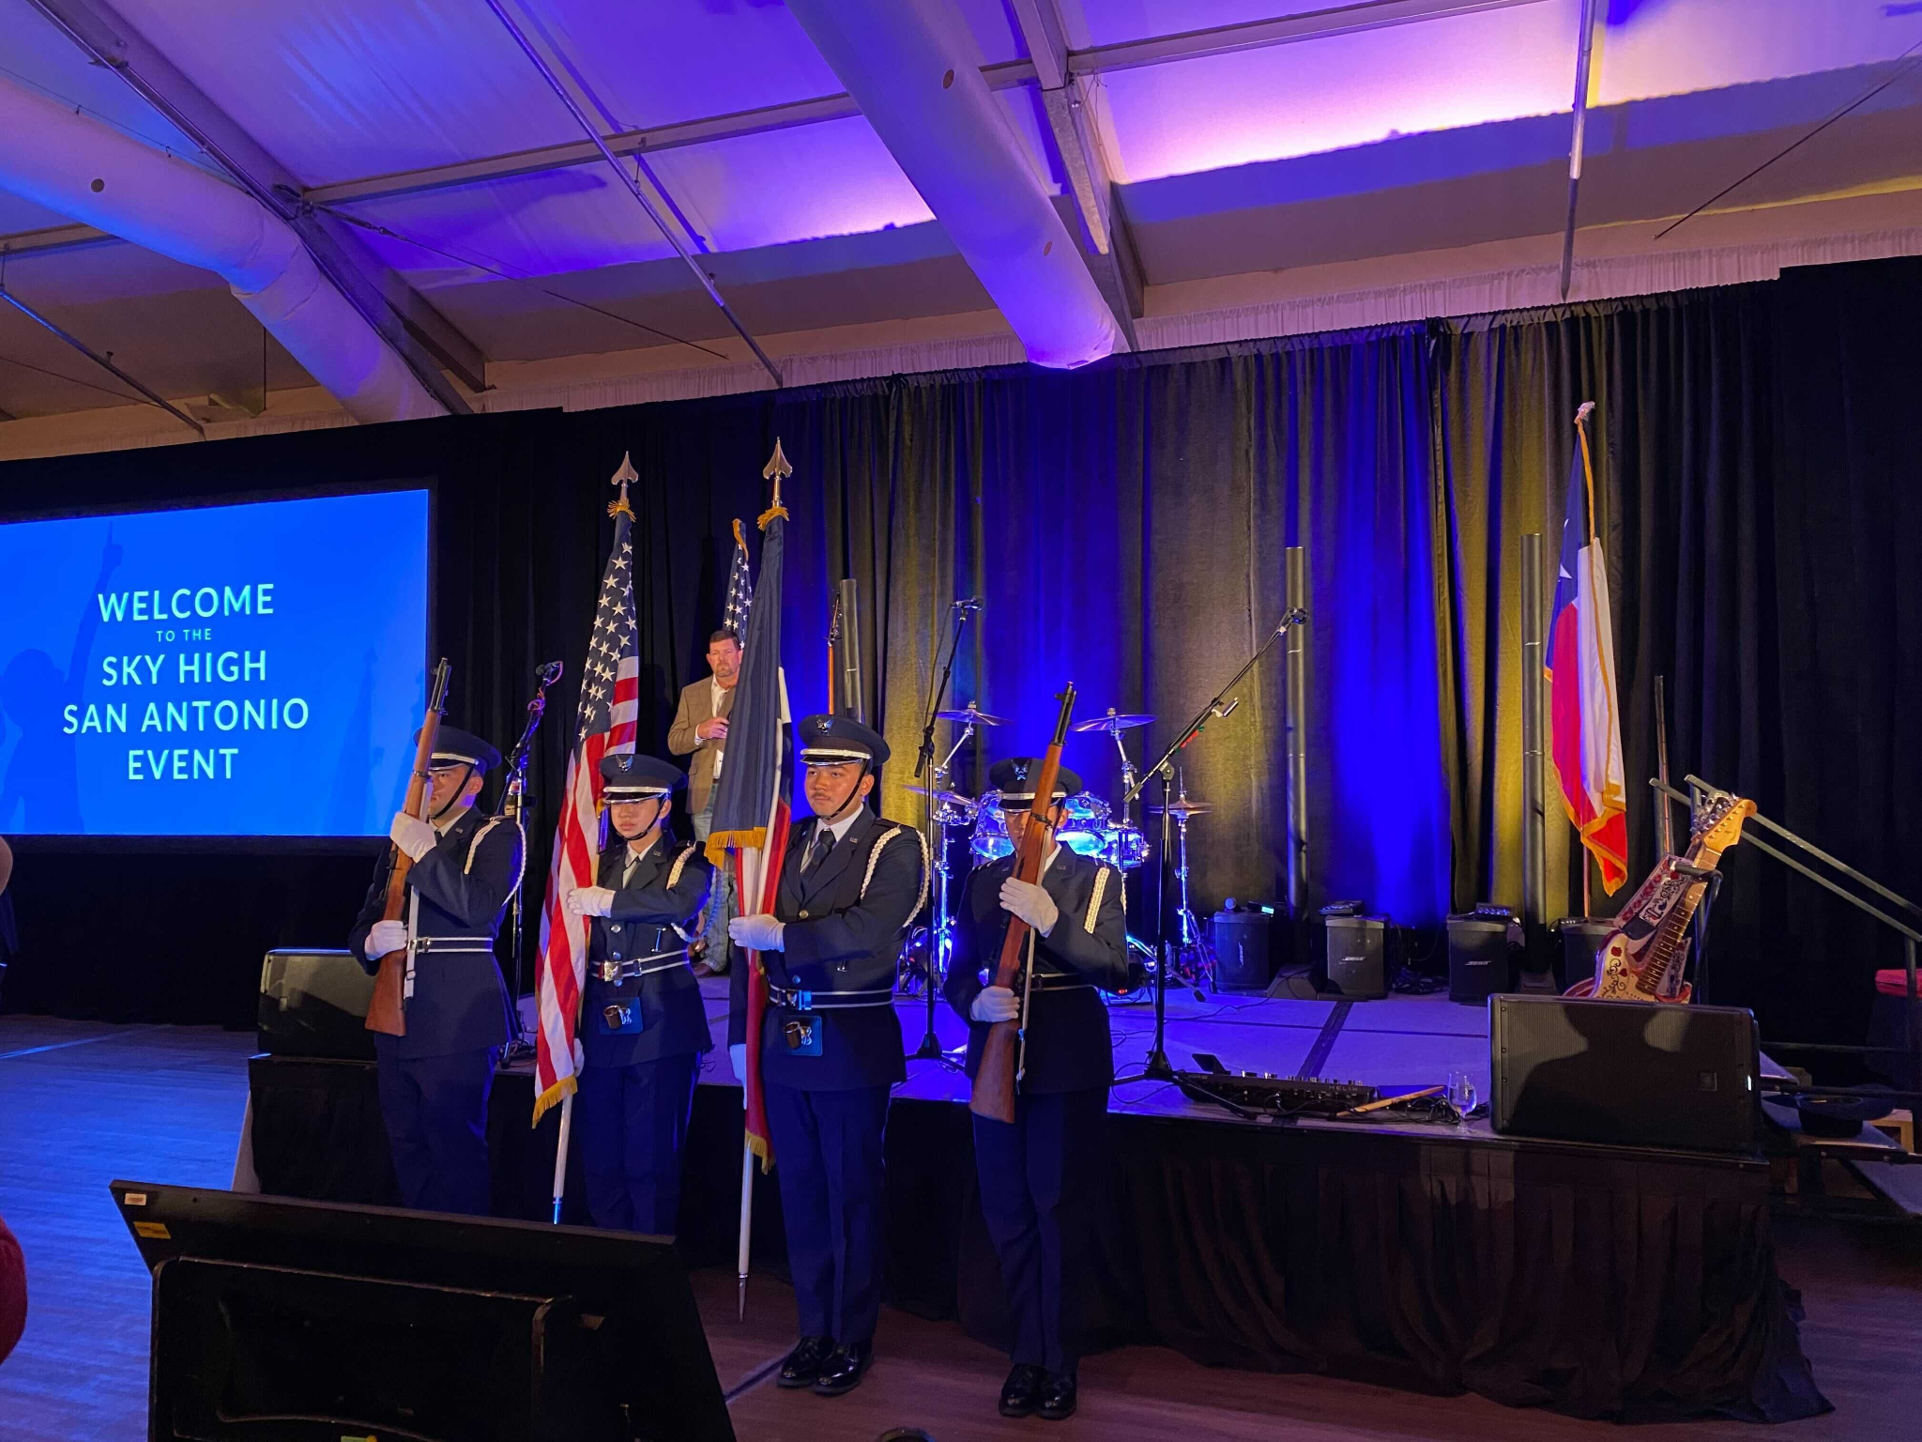
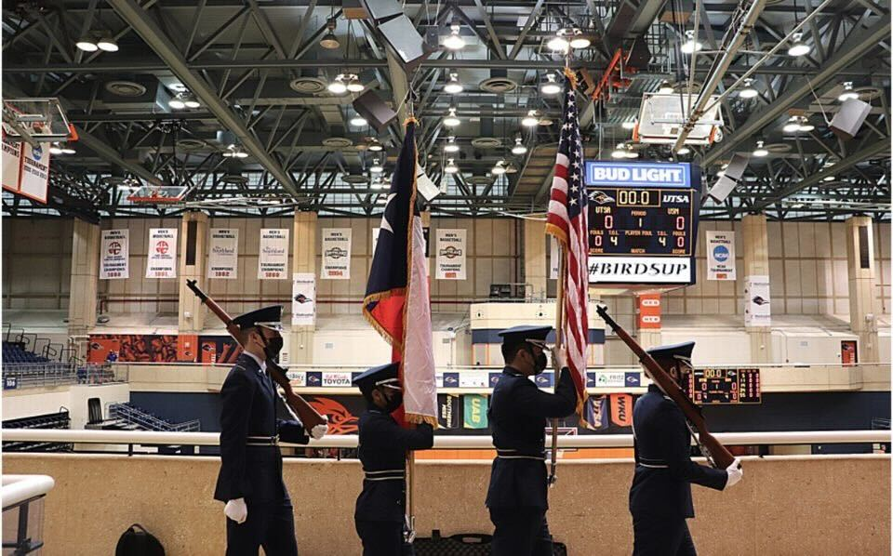
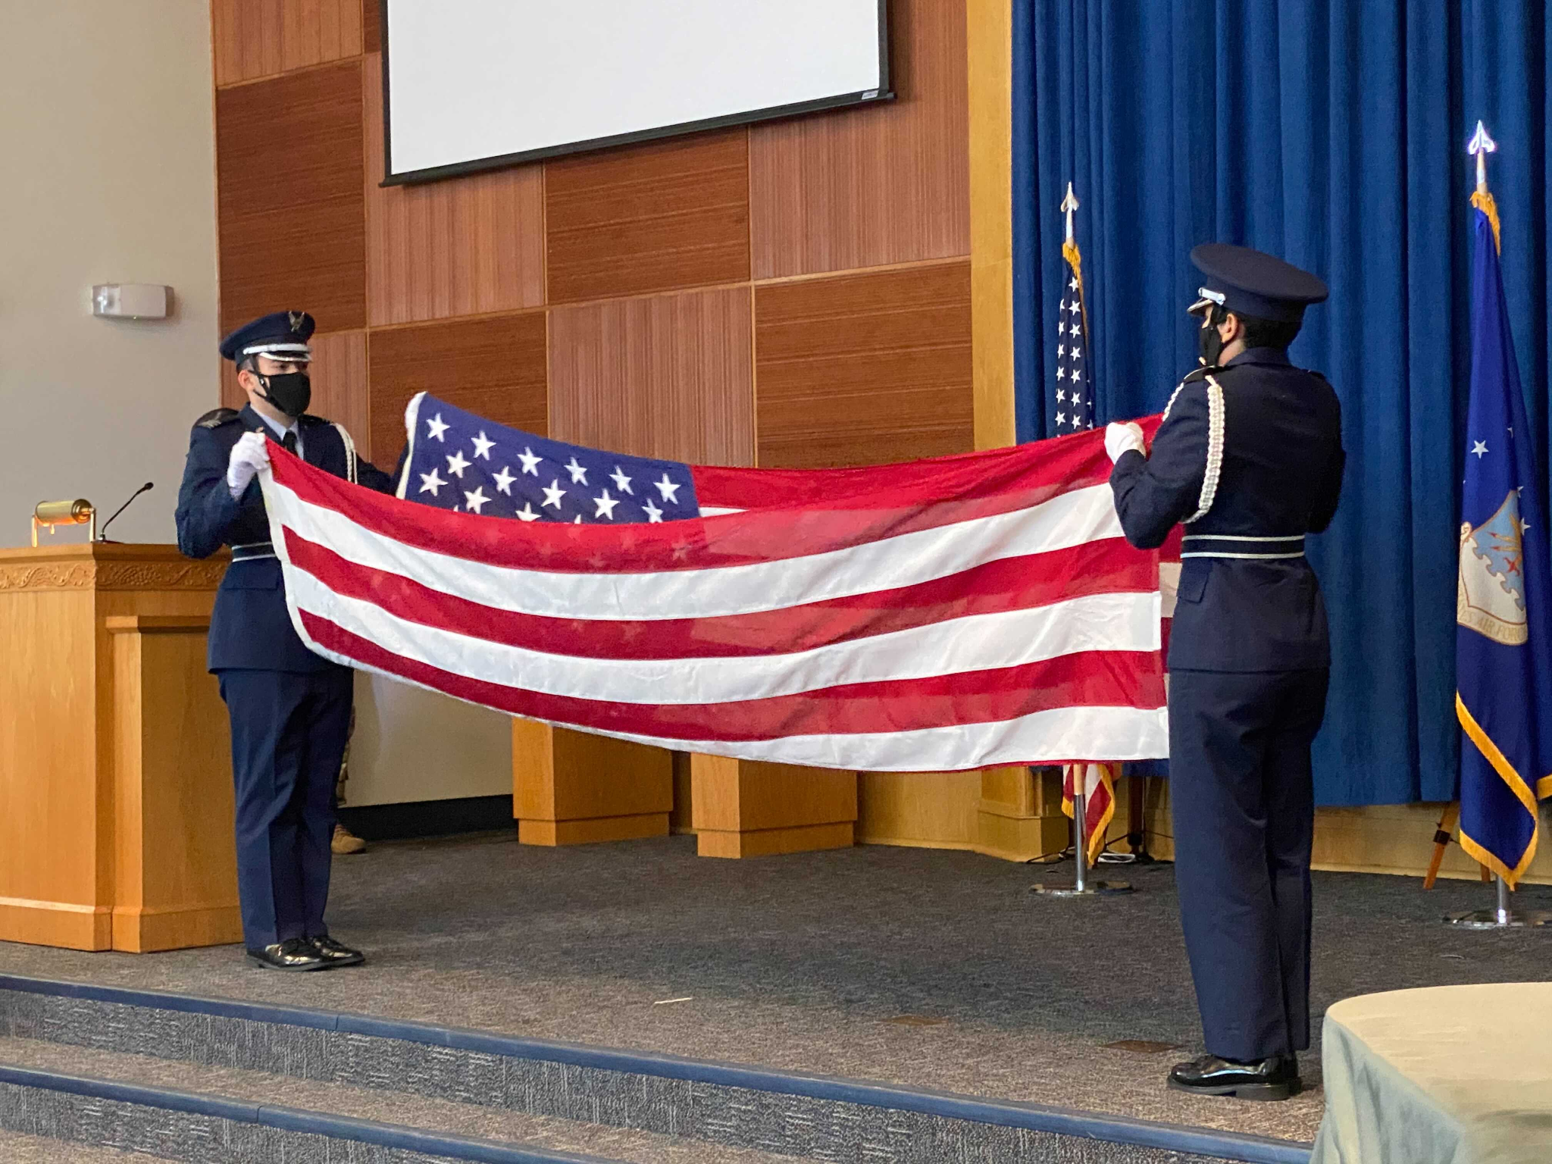
Event Pictures
Serve the community in many ways!
Air Force ROTC Detachment 842 • We Build Exceptional Officers • The University of Texas at San Antonio
Notes:
Pictures can be added to the slide show.

Slide 31
Expectations

Slide 32
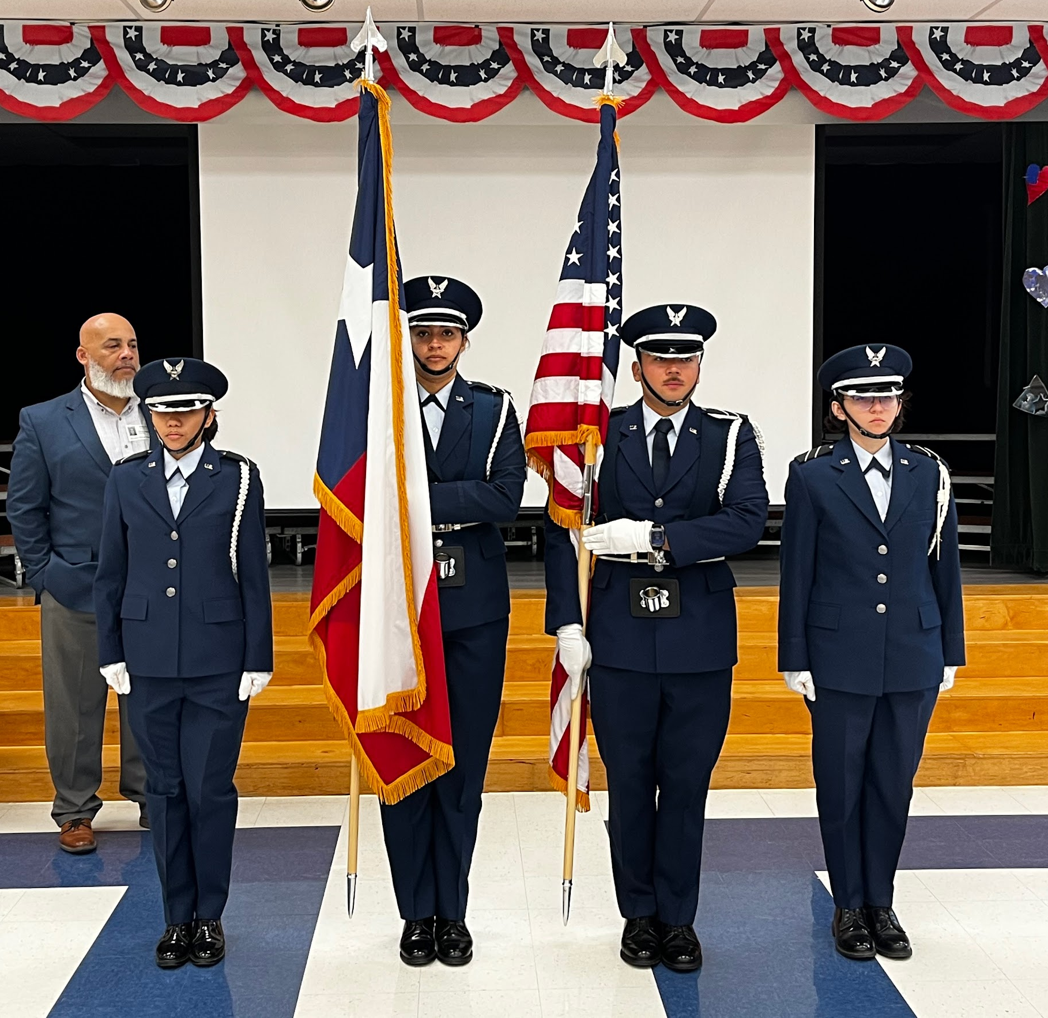
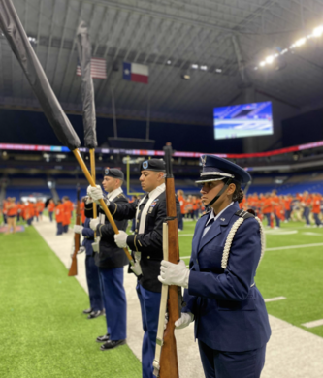
What Is Expected
Determination
Dedication
Attend Practices
Team Mindset
Good Attitude!
Represent the Best = Look the Best
Air Force ROTC Detachment 842 • We Build Exceptional Officers • The University of Texas at San Antonio
Notes:
Pictures can be added to the slide show.

Slide 33
Benefits

Slide 34
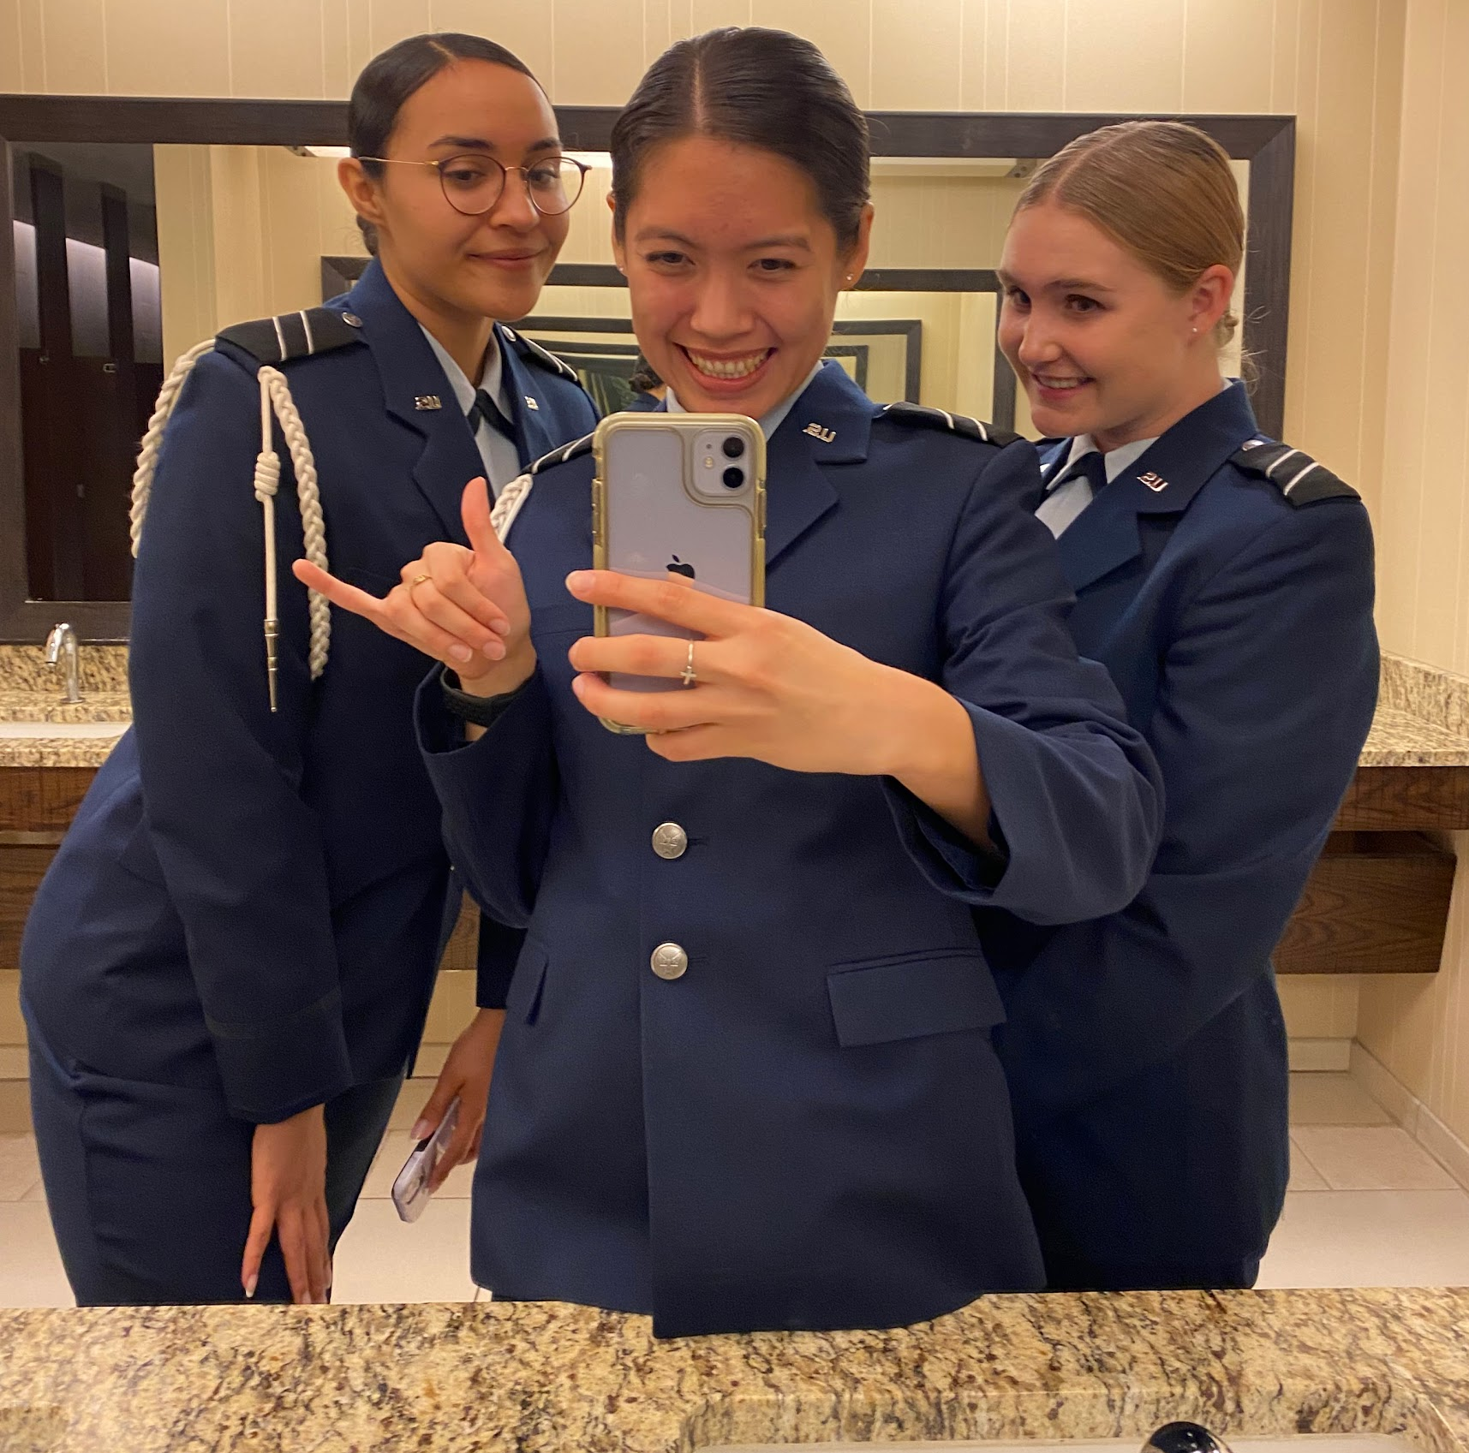
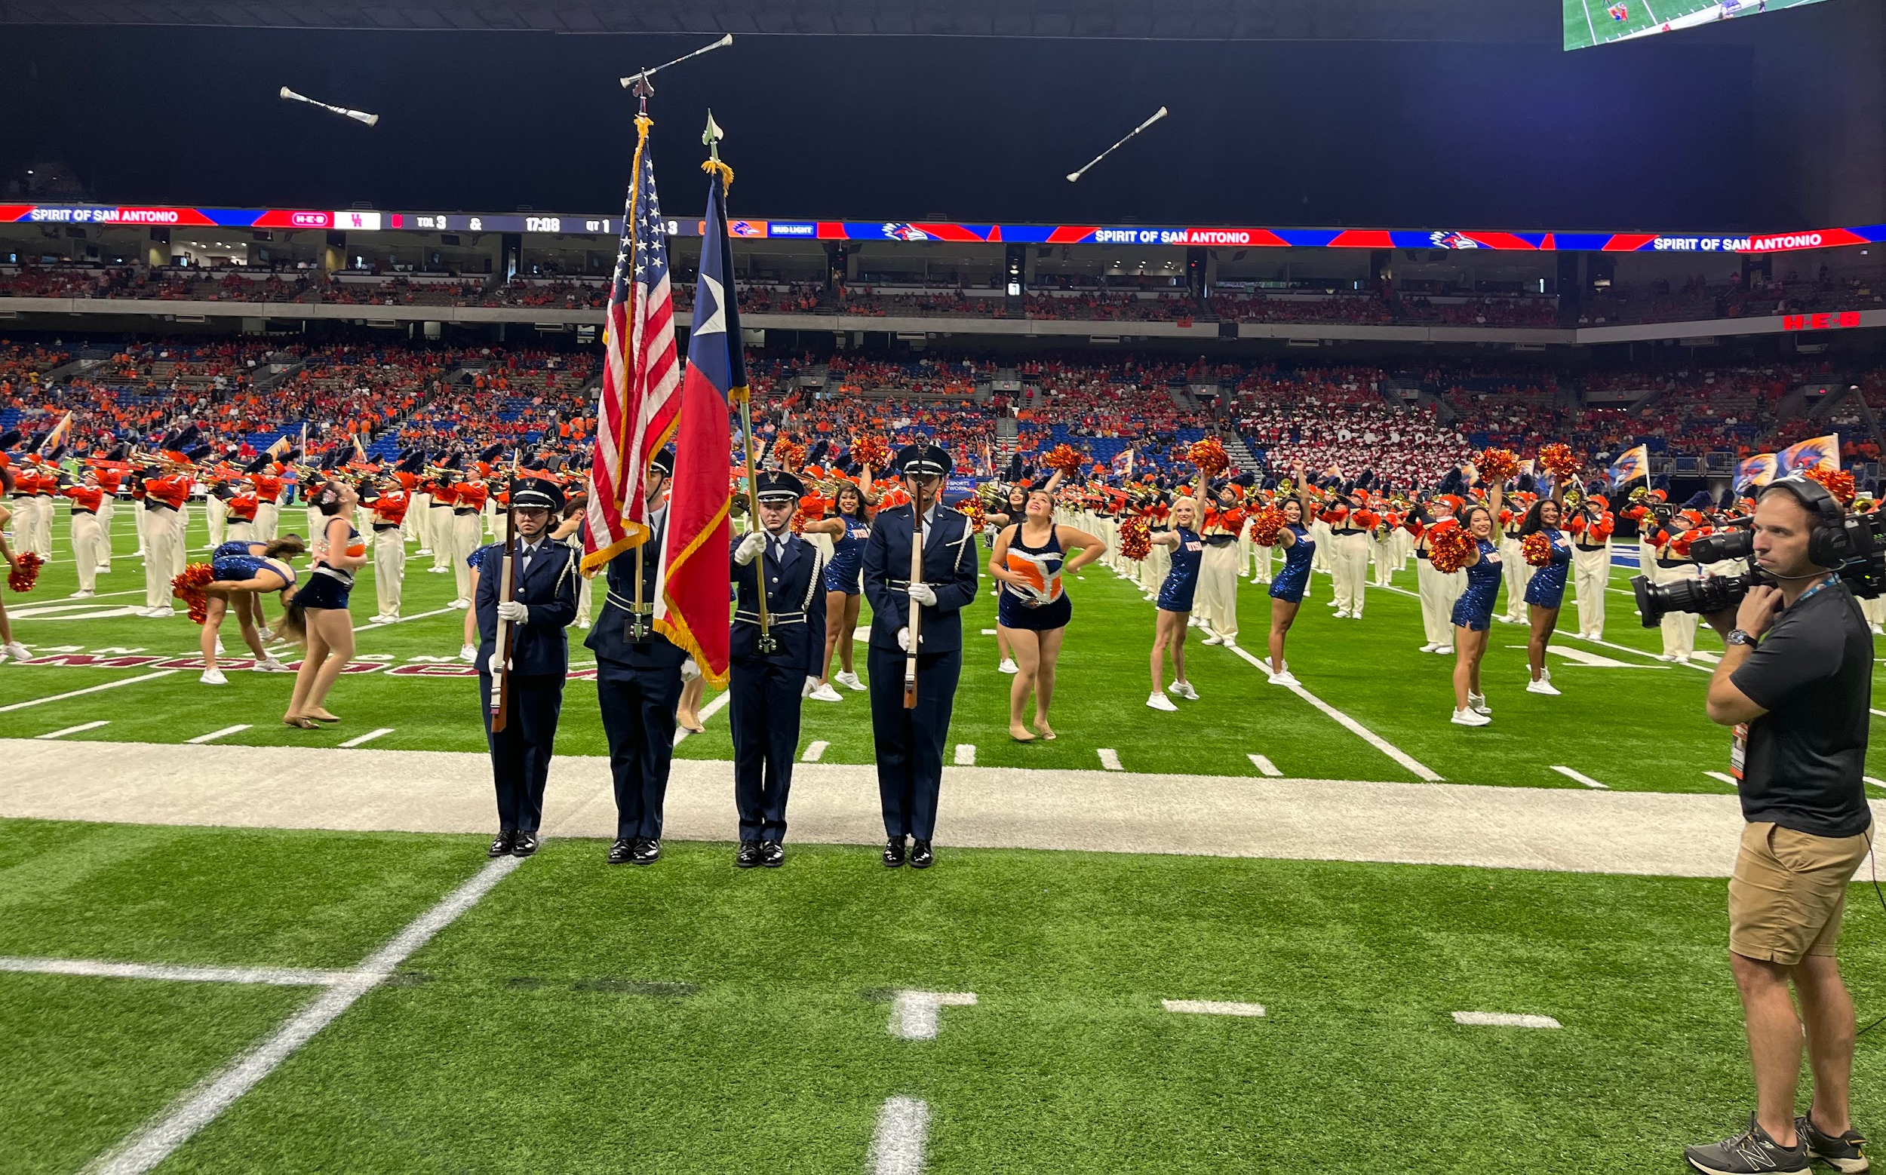
Benefits of Being In HG
Leadership
Connection with Peers
Opportunities / Stand Out
Getting your blues early!
Air Force ROTC Detachment 842 • We Build Exceptional Officers • The University of Texas at San Antonio
Notes:
Pictures can be added to the slide show.

Slide 35
Practices

Slide 36
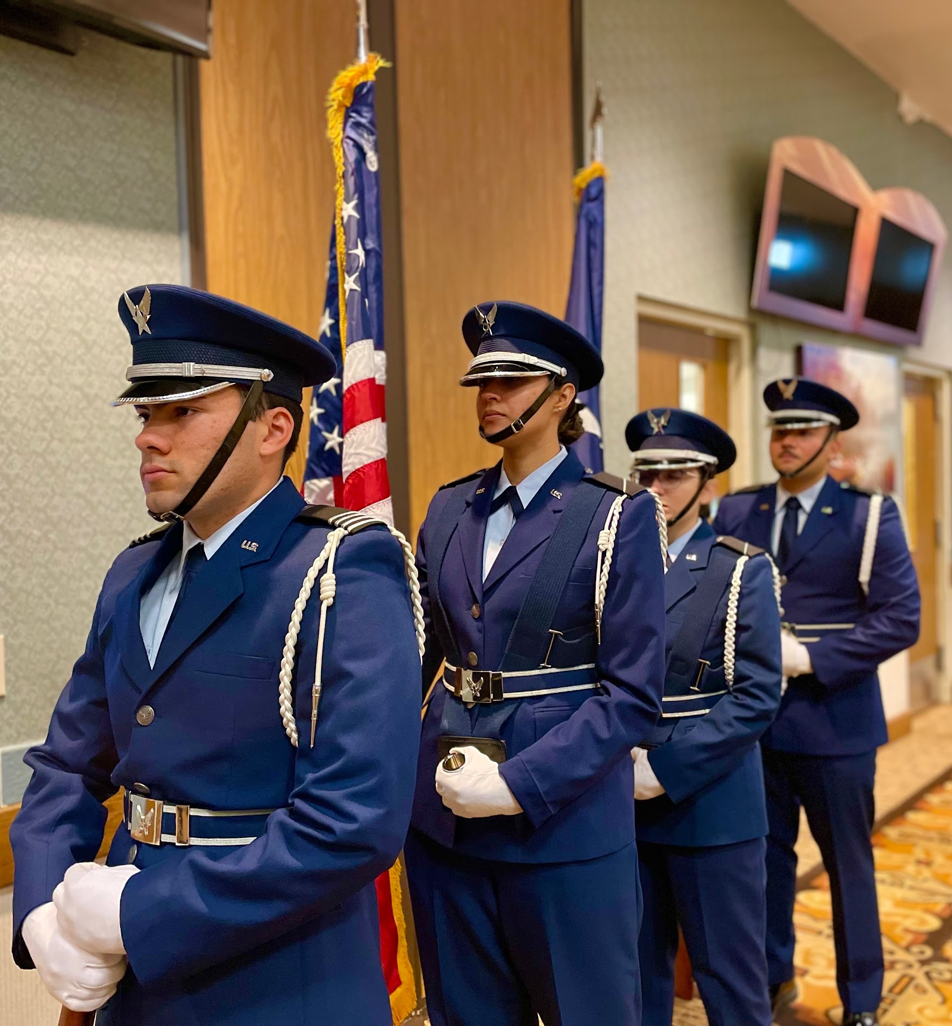
Practices
Every Tuesday & Friday
3-4pm
If you can’t attend every practice
we will work with you
Air Force ROTC Detachment 842 • We Build Exceptional Officers • The University of Texas at San Antonio
Notes:
Pictures can be added to the slide show.

Slide 37
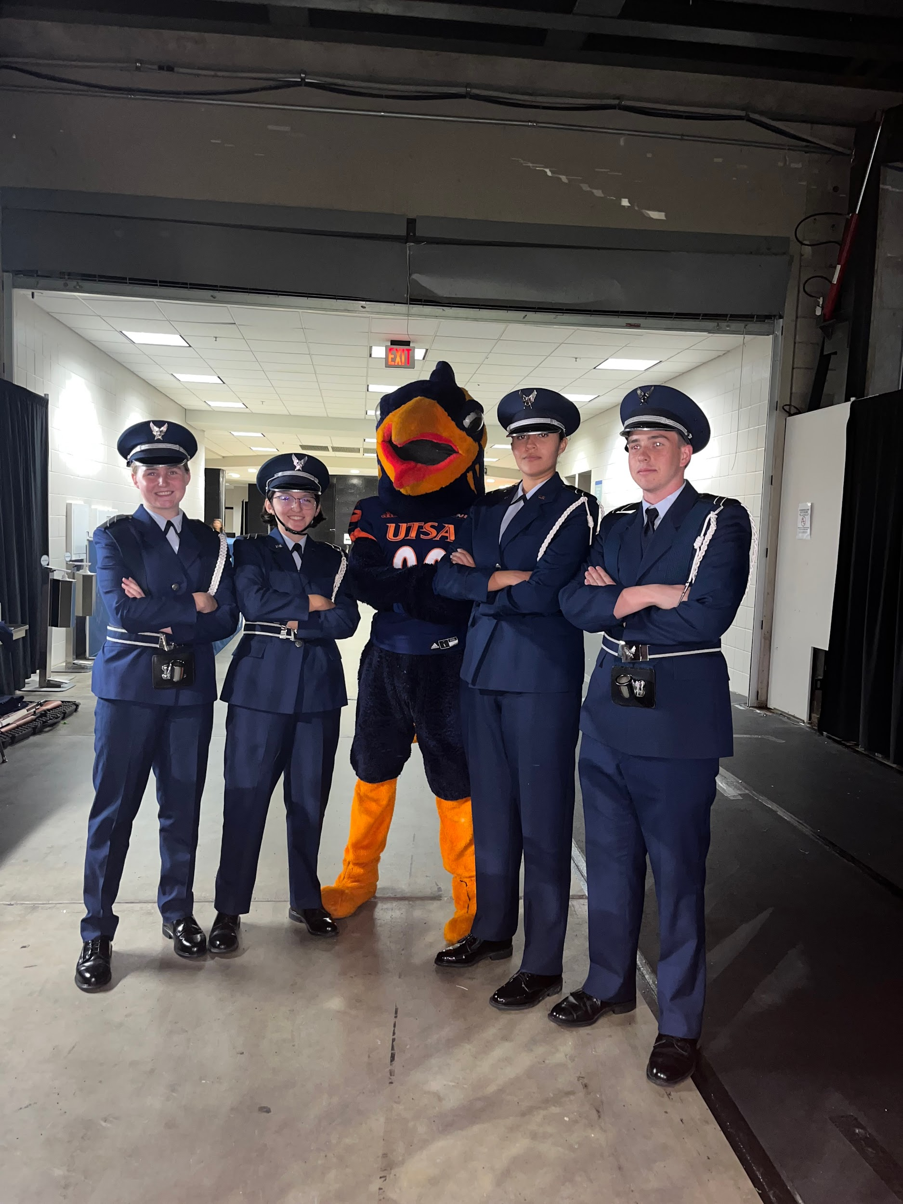
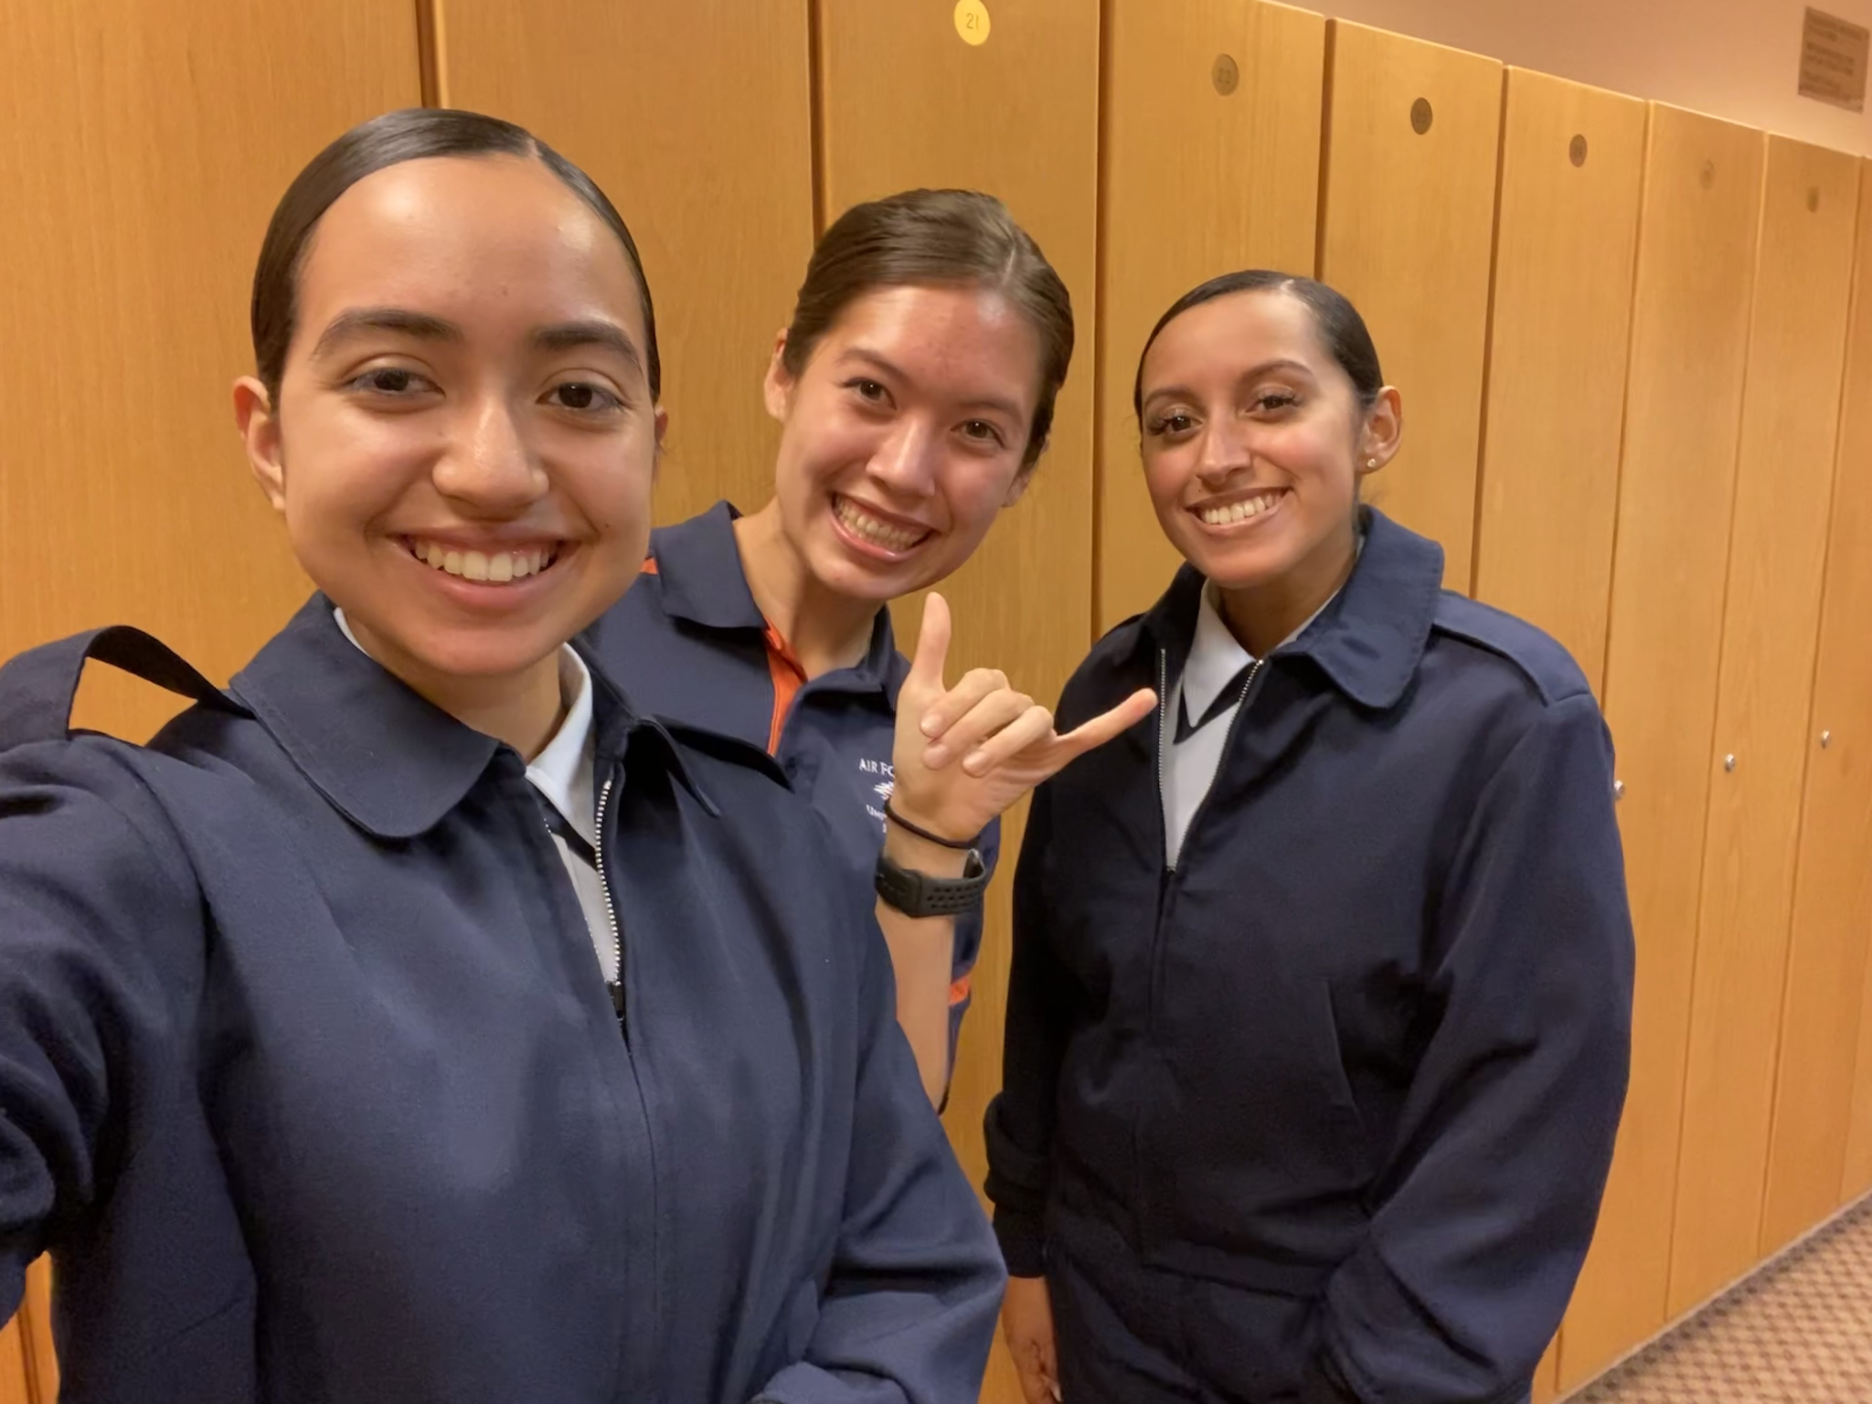
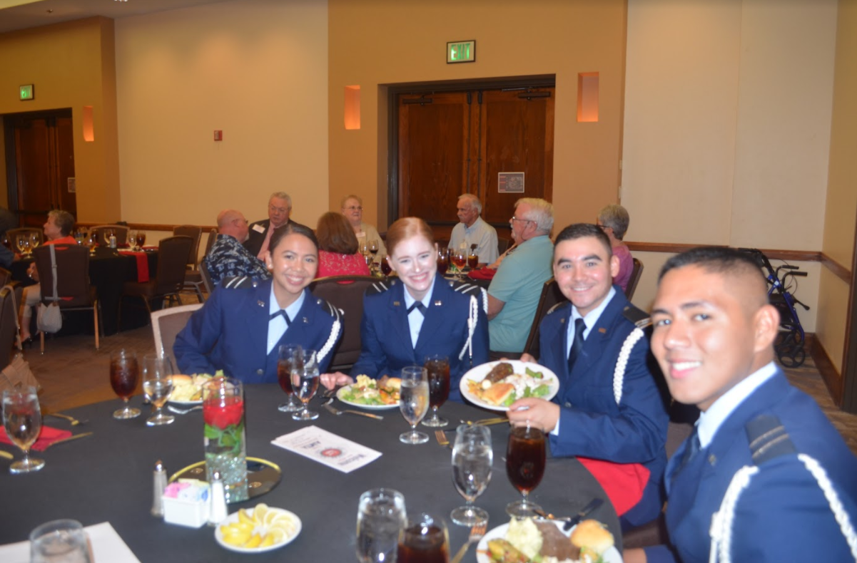
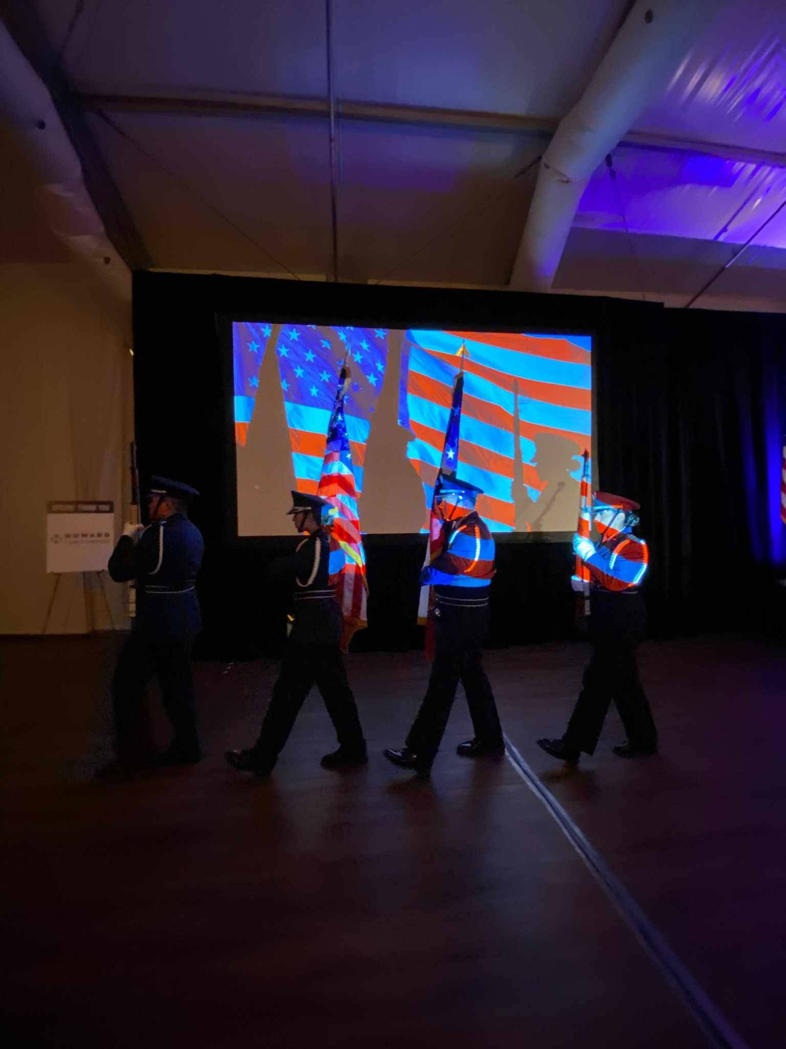
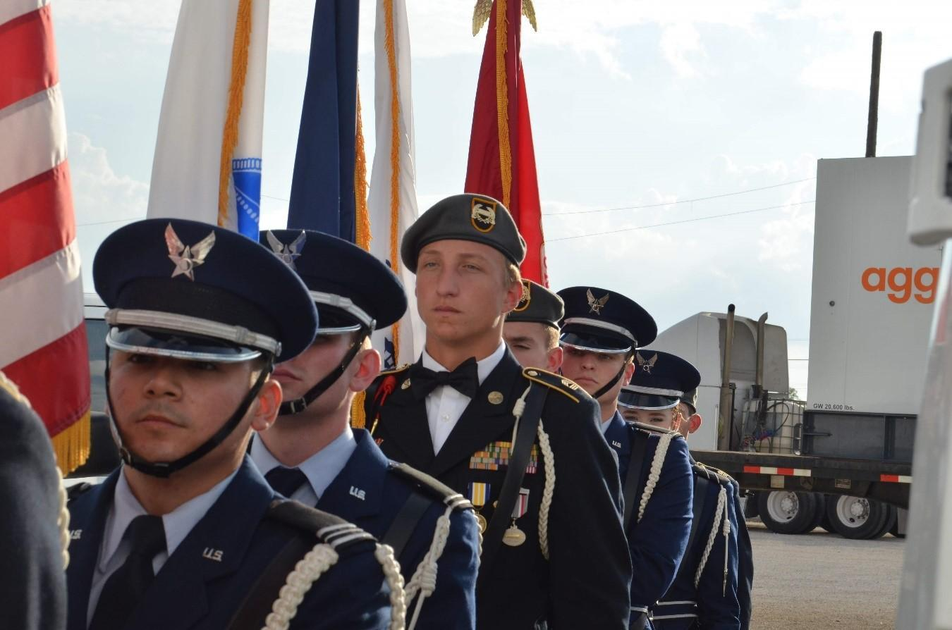
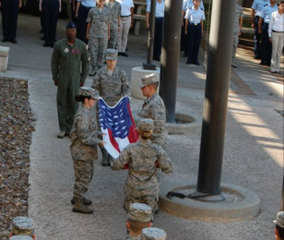
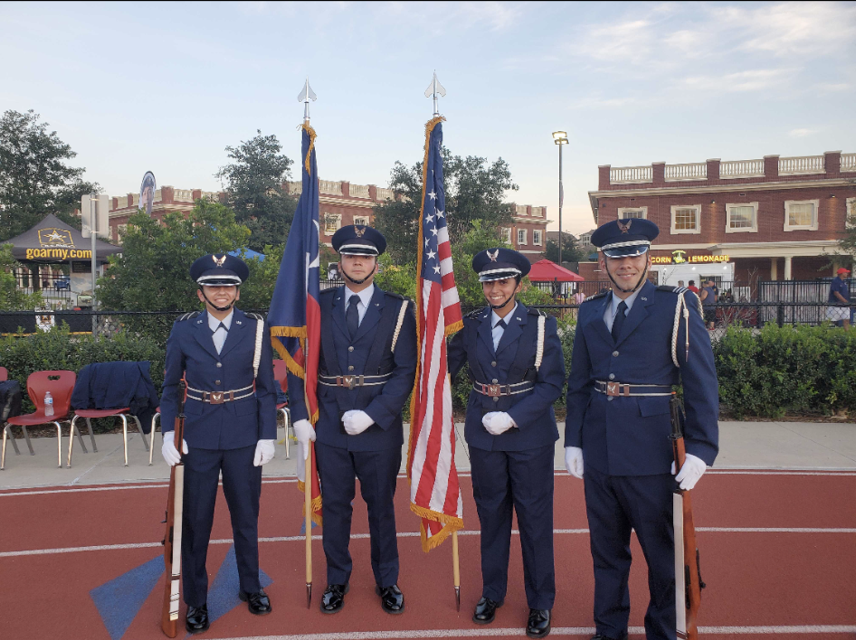
More Event Pictures
Air Force ROTC Detachment 842 • We Build Exceptional Officers • The University of Texas at San Antonio
Notes:
Pictures can be added to the slide show.

Slide 38

Summary
What is HG?
Expectations
Benefits
Practices
Summary
Air Force ROTC Detachment 842 • We Build Exceptional Officers • The University of Texas at San Antonio
Notes:
Should mirror the Overview

Slide 39
Questions?

Slide 40
Air Force ROTC Detachment 842
The University of Texas at San Antonio
Det 842 – Best in Blue

Slide 41
Det 842 Silver Wings
Air Force ROTC Detachment 842
The University of Texas at San Antonio
C/ Wargo
10 Jan 24

Slide 42
Overview
What is Silver Wings?
What Do We Offer?
Who Can Join?
Air Force ROTC Detachment 842 • We Build Exceptional Officers • The University of Texas at San Antonio

Slide 43
What is Silver Wings?

Slide 44
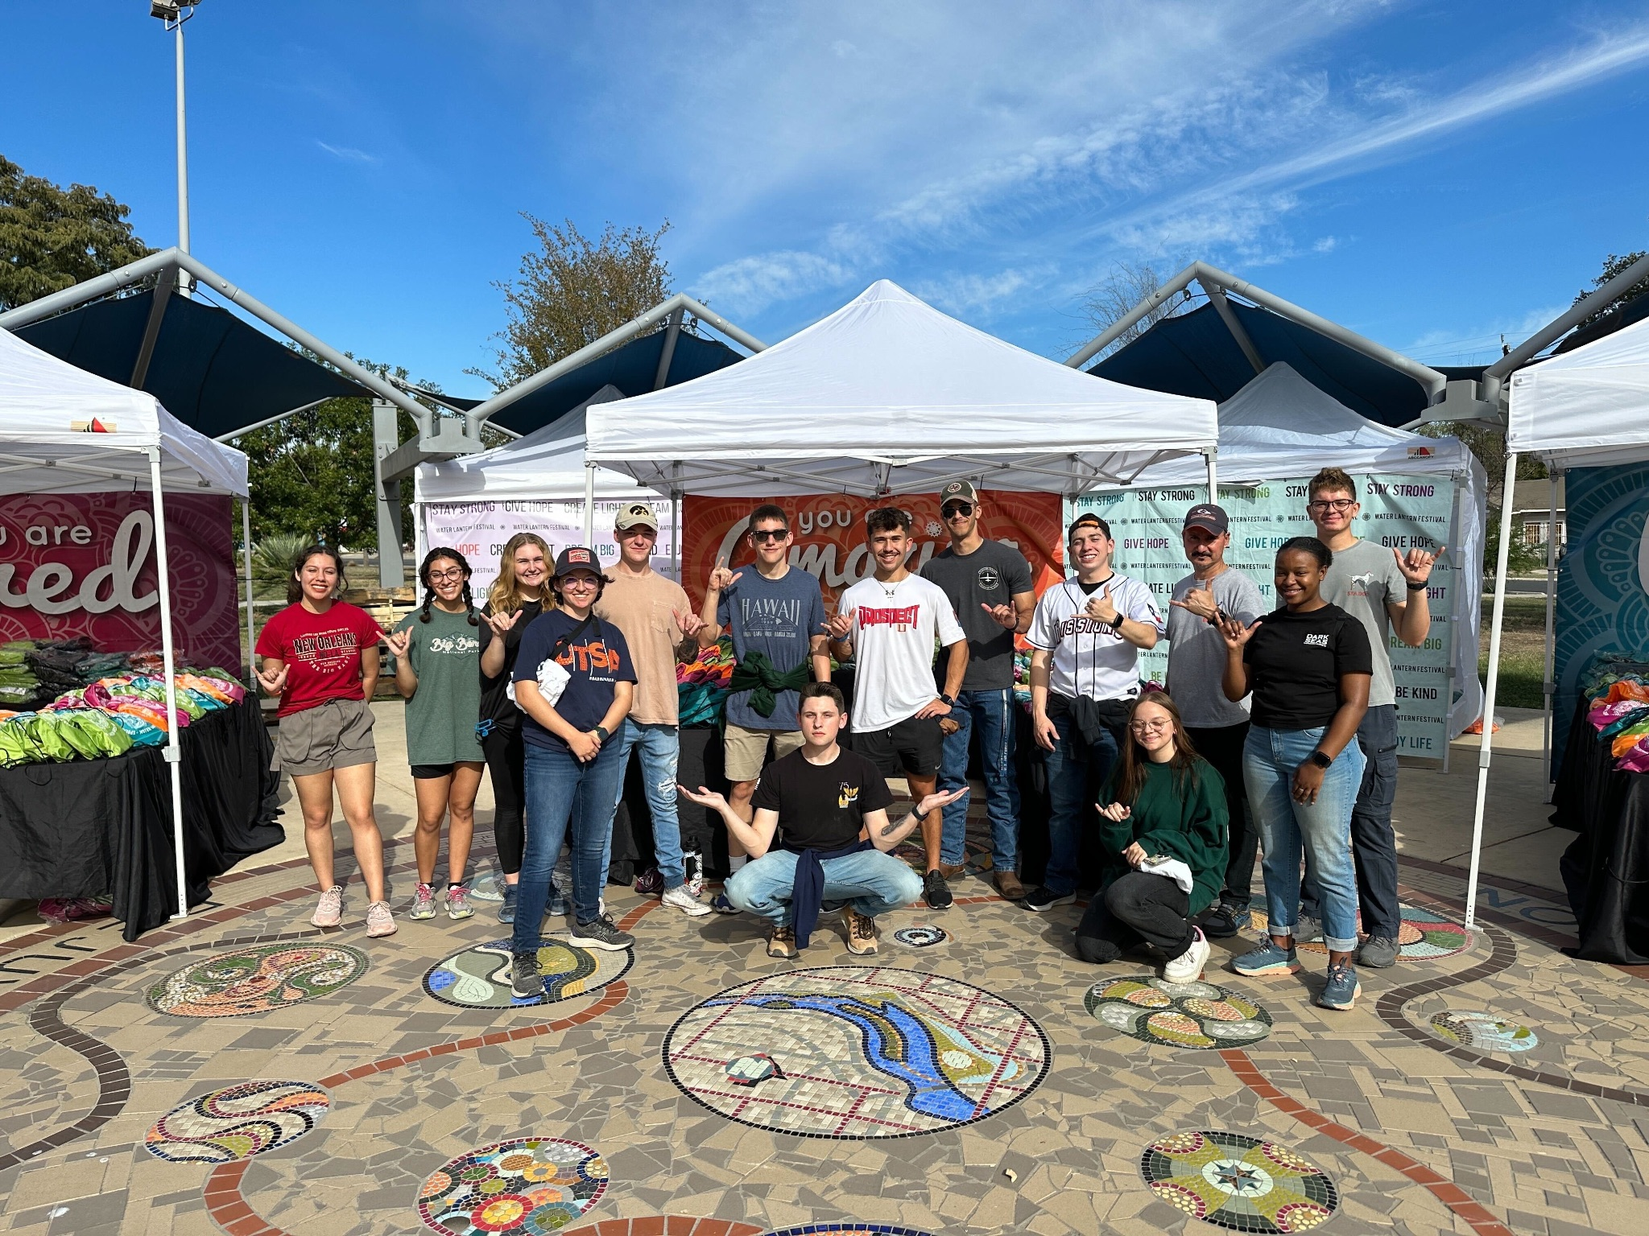
What Is Silver Wings?
Personal and professional development regardless of your career choice.
Air Force ROTC Detachment 842 • We Build Exceptional Officers • The University of Texas at San Antonio

Slide 45
What Do We Offer?

Slide 46
What Do We Offer?
Networking In and Out of AFROTC
Regional and National Leadership Opportunities
Internships and Scholarships
Community Service Opportunities
Air Force ROTC Detachment 842 • We Build Exceptional Officers • The University of Texas at San Antonio
Notes:
Pictures can be added to the slide show.

Slide 47
Who Can Join?

Slide 48
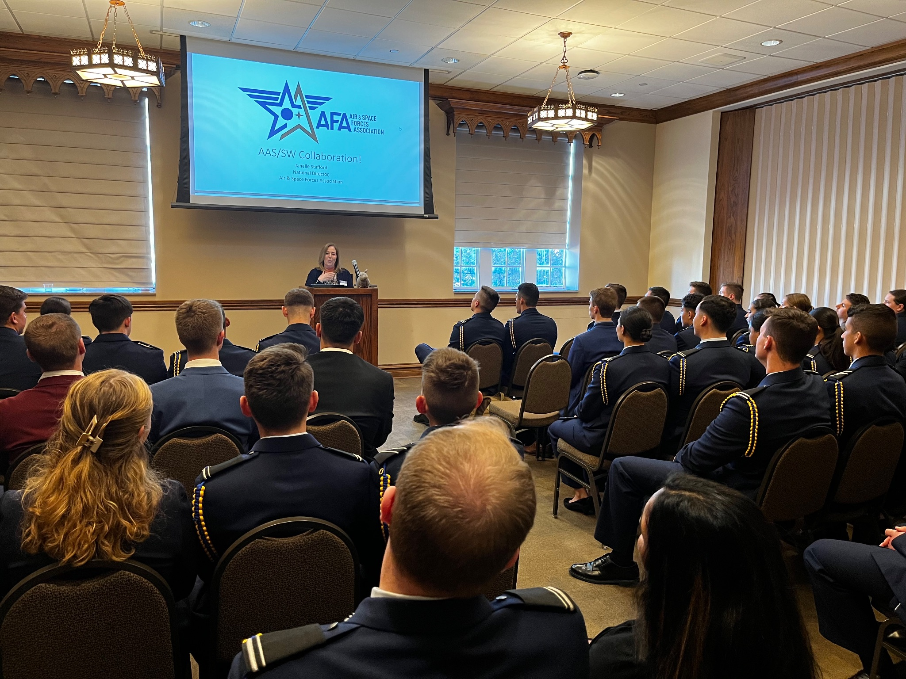
Who Can Join?
Air Force Cadets
Army Cadets
Civilian College Students
Air Force ROTC Detachment 842 • We Build Exceptional Officers • The University of Texas at San Antonio
Notes:
Pictures can be added to the slide show.

Slide 49
Summary
What is Silver Wings?
What Do We Offer?
Who Can Join?
Air Force ROTC Detachment 842 • We Build Exceptional Officers • The University of Texas at San Antonio

Slide 50
Questions?

Slide 51
Air Force ROTC Detachment 842
The University of Texas at San Antonio
Det 842 – Best in Blue

Slide 52



i5 SPACE
January 11, 2024
C/3C Atkinson

Slide 53

Overview
What is i5?
Opportunities
How to Join

Slide 54


What is i5?
National Student Organization
USSF SPACE TRAINING AND READINESS COMMAND (STARCOM)
GOALS:
- EDUCATE
- TRAIN
- DEVELOPMENT RESOURCES
Notes:
i5 Space is a national student organization that operates in conjunction with the U.S. Space Force’s Space Training and Readiness Command (STARCOM). We aim to deliver educational, training, and professional development resources to students around the country who are interested in pursuing a career in the newest branch of the US military—the Space Force. We are growing every day and currently boast more than 850 members from 54 different Squadrons! We are also proud to have research partnerships with the Space Force and NATO.

Slide 55
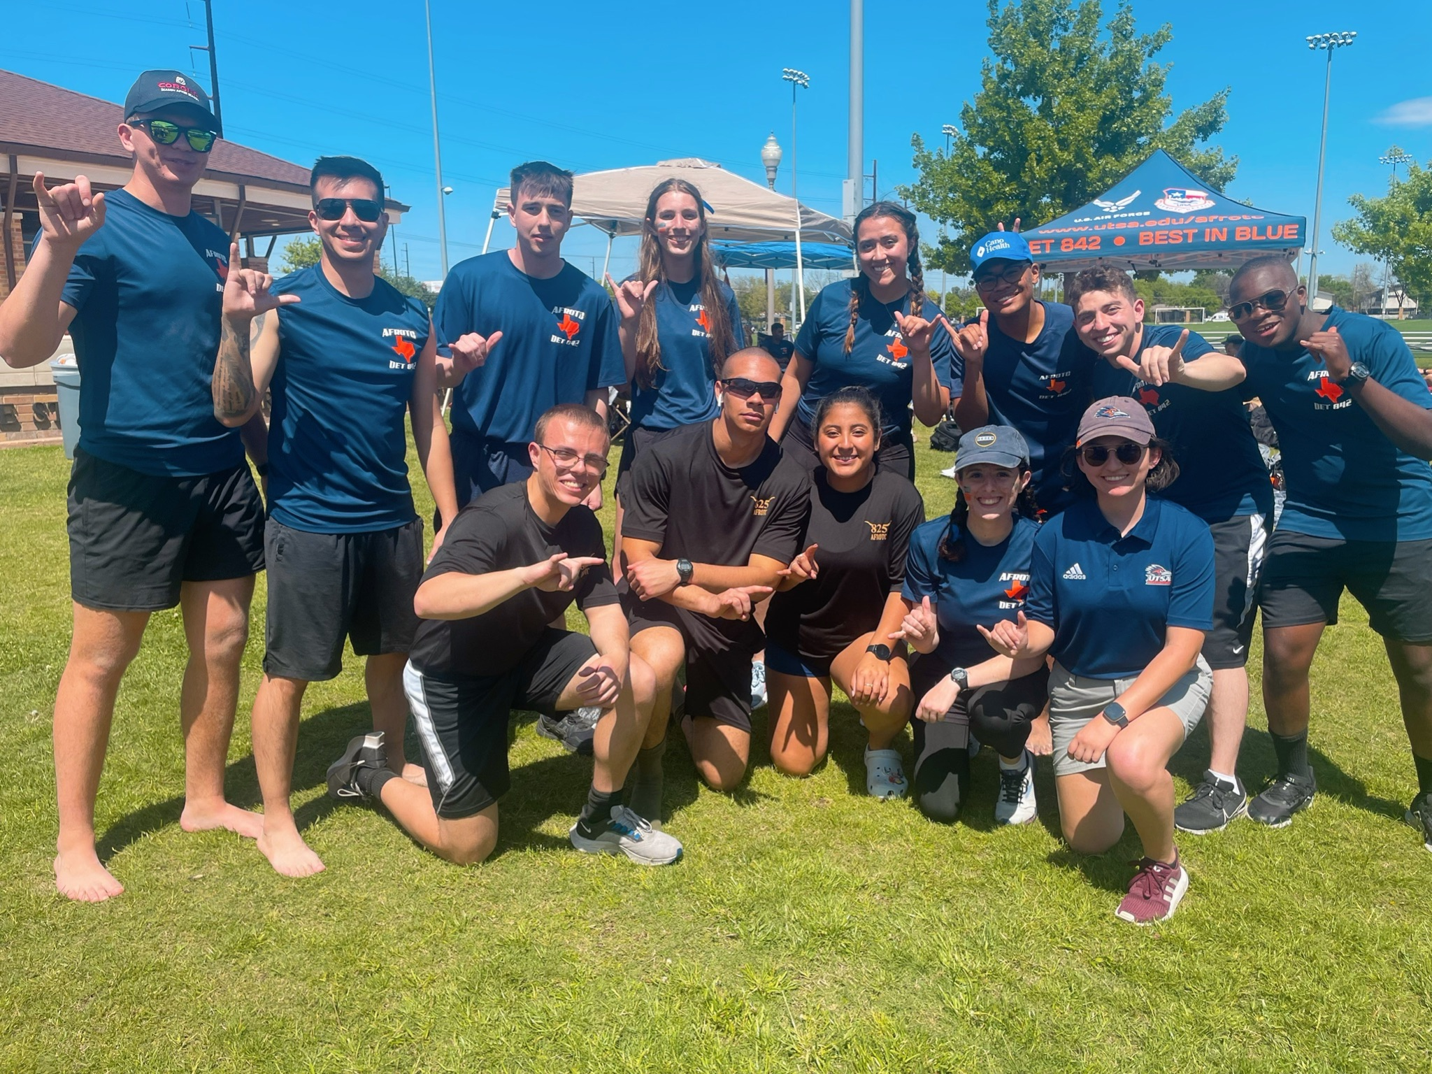


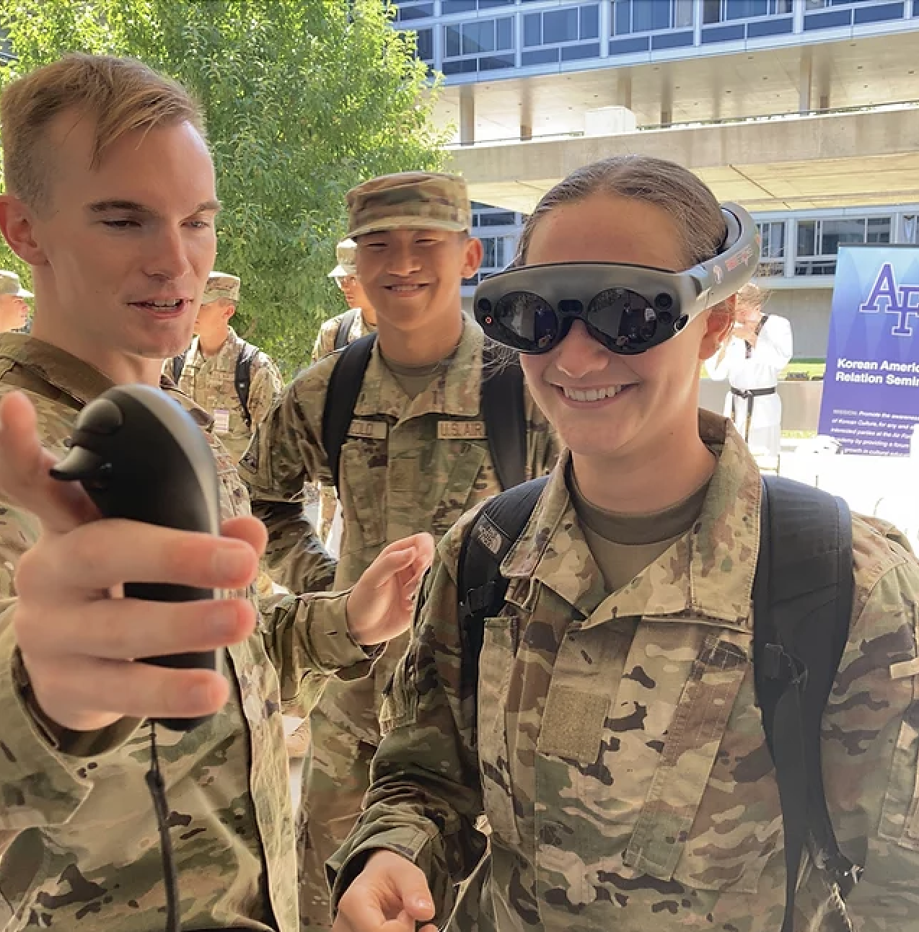
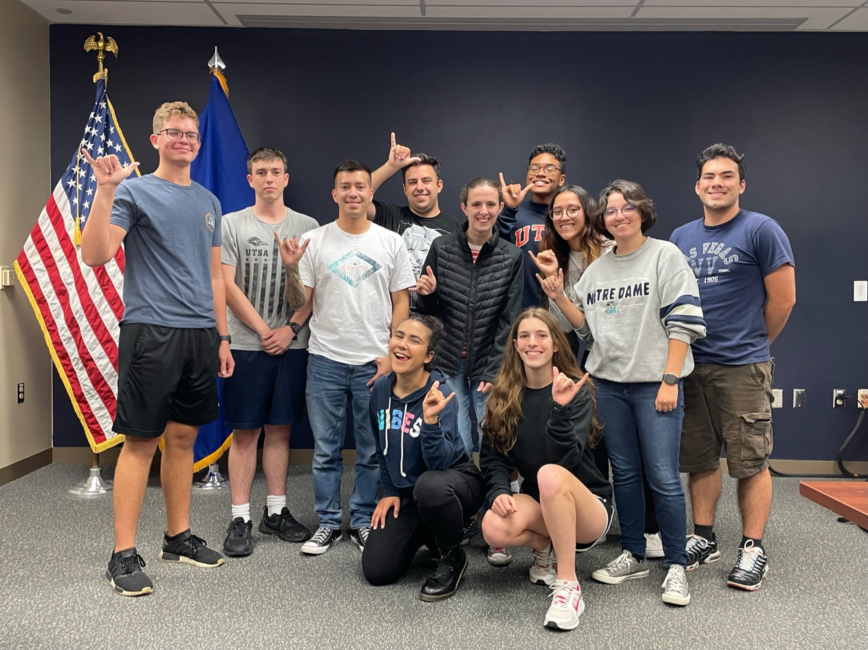

Opportunities
Research
Education
Mentorship
Space Operation Officers
Cyber Officers
Developmental Engineers
Intelligence Officers
Acquisitions
Wargaming
Cyberwarfare

Slide 56
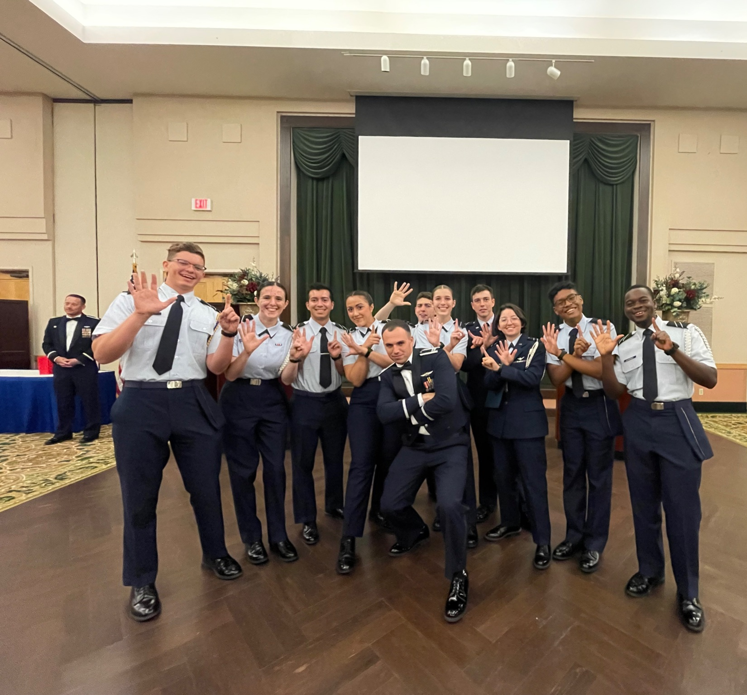
How to join
Join our Slack channel
Meetings on Wednesdays 1600
Visit our website
i5space.com

Slide 57

Questions?

Slide 58
Booster Club
Air Force ROTC Detachment 842
The University of Texas at San Antonio
C/Olivares
11 Jan 24

Slide 59
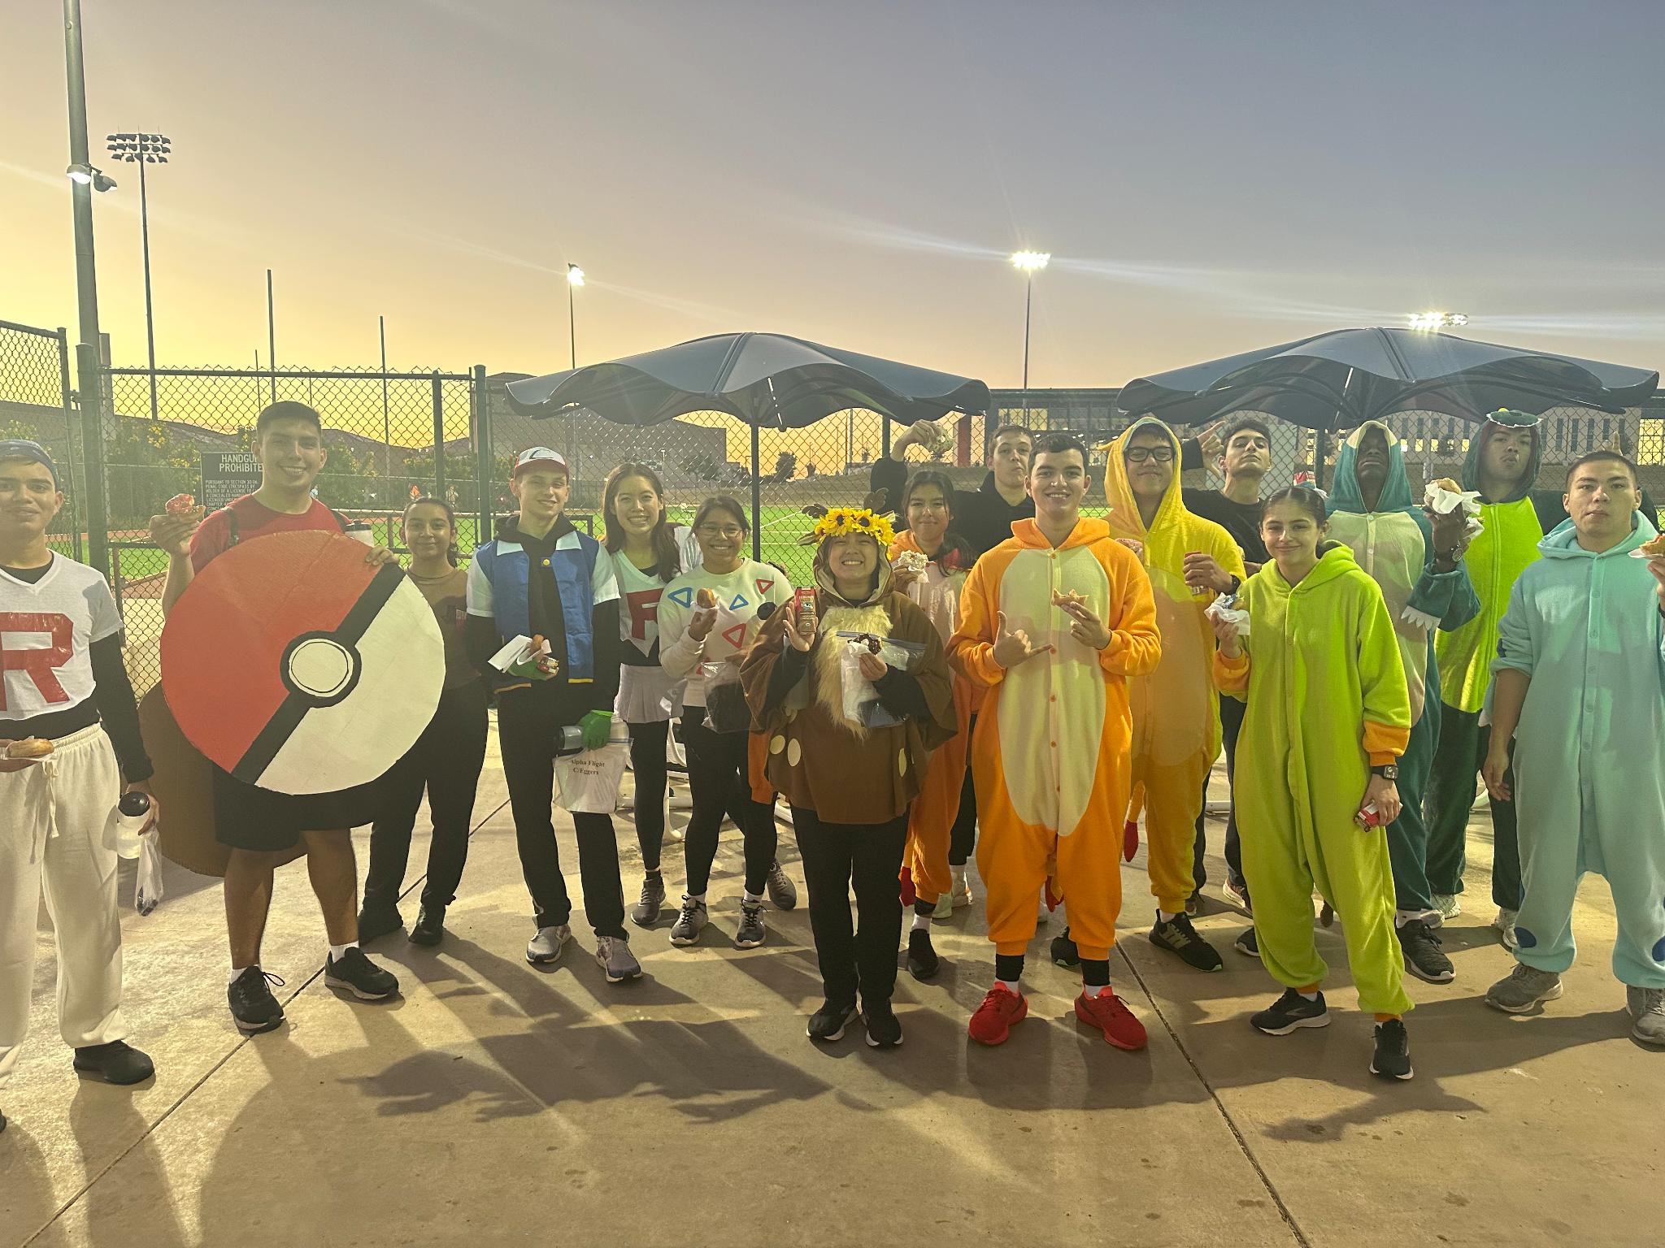
Overview
What Is Booster Club
Why Join
How To Join
Officers
Merchandise
Questions
Air Force ROTC Detachment 842 • We Build Exceptional Officers • The University of Texas at San Antonio

Slide 60
What Is Booster Club

Slide 61

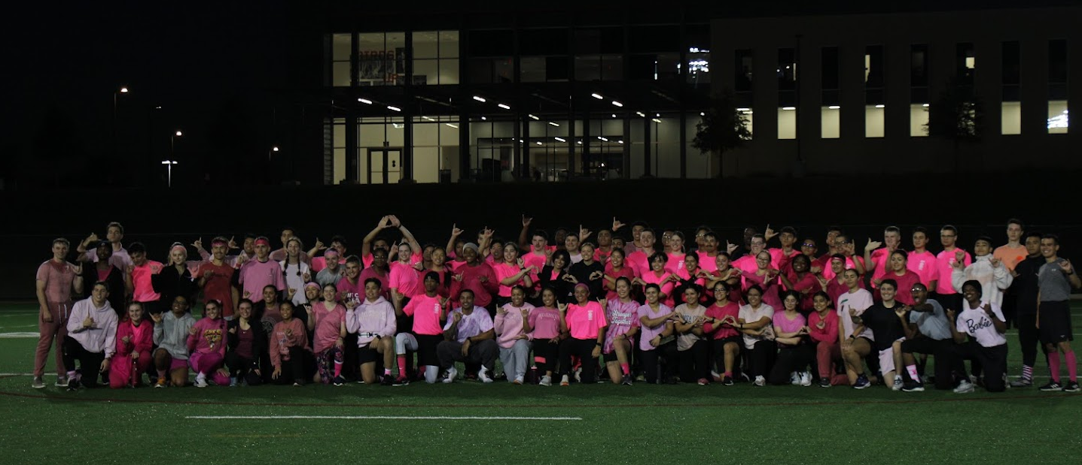
What Is Booster Club
Fundraising
Provides snack bar for detachment
Sell Merchandise
Fund Morale Events
Air Force ROTC Detachment 842 • We Build Exceptional Officers • The University of Texas at San Antonio

Slide 62
Why Join?

Slide 63
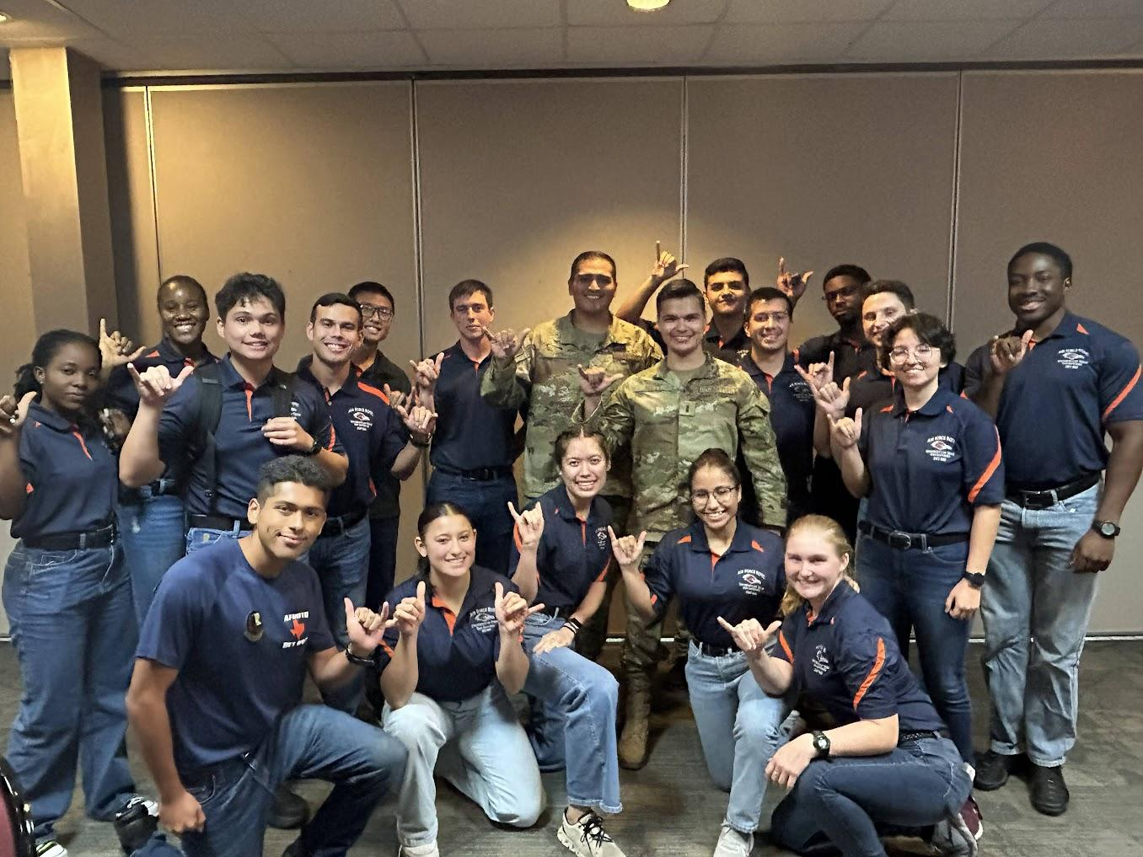
Why Join?
Booster Club offers the opportunity to hold a leadership position as GMC
Mentorship
Experience leading projects
Opportunities to connect and work with
others throughout the detachment
Air Force ROTC Detachment 842 • We Build Exceptional Officers • The University of Texas at San Antonio

Slide 64
How To Join

Slide 65
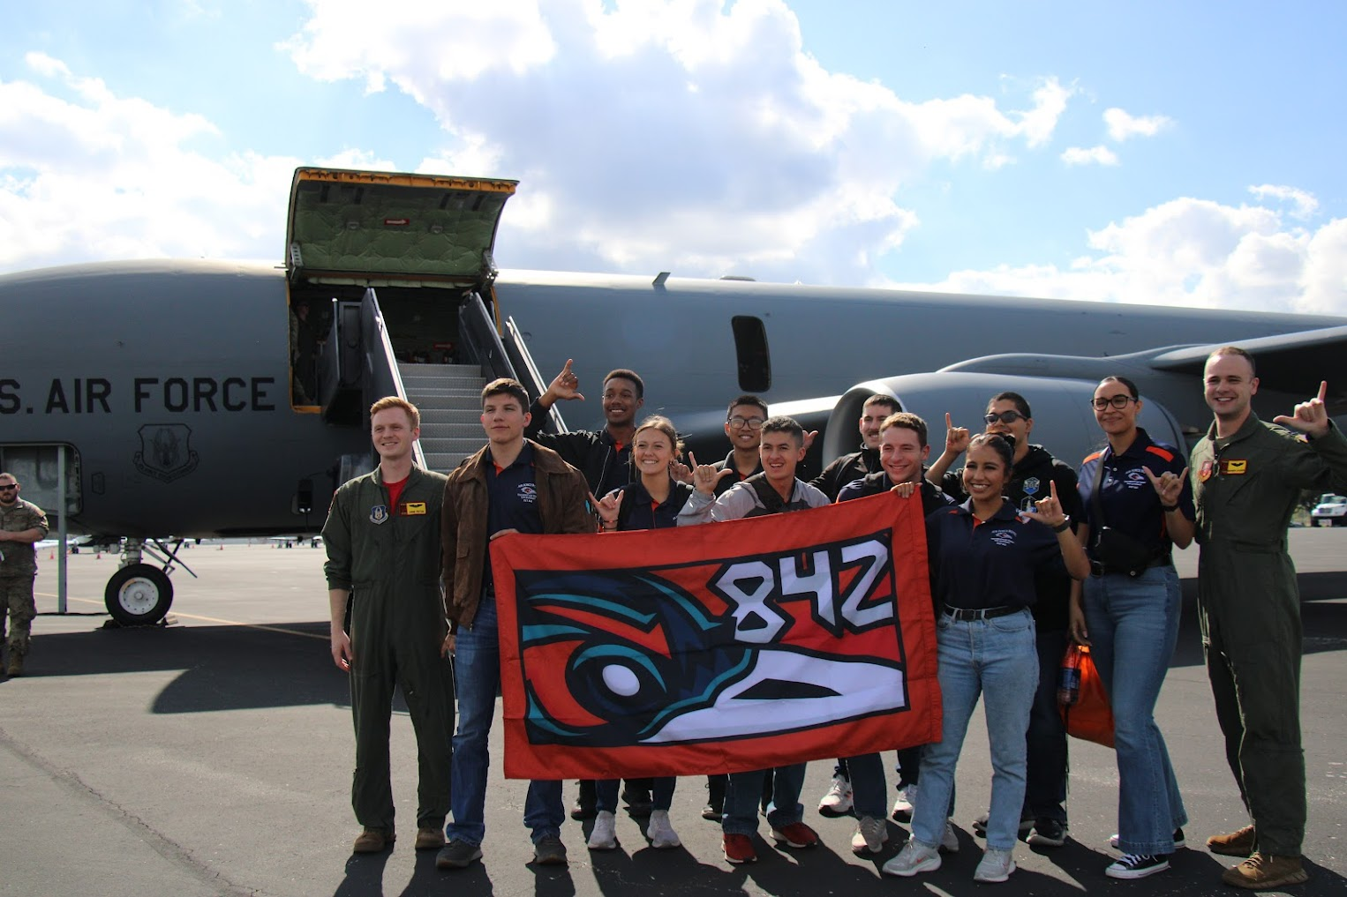
How To Join
Attend Booster Club meetings
Meetings are every other week after Thursday LLAB
Air Force ROTC Detachment 842 • We Build Exceptional Officers • The University of Texas at San Antonio

Slide 66
Officers

Slide 67
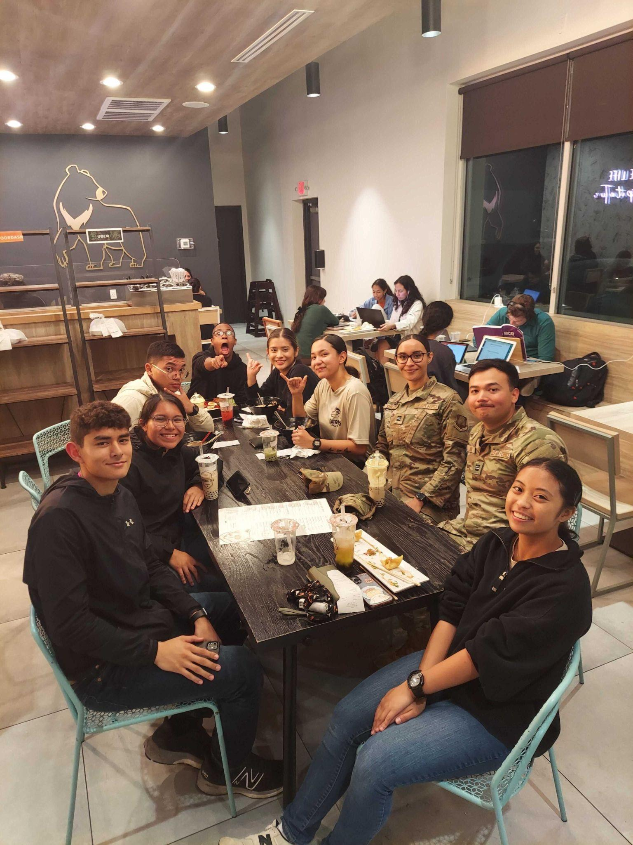
Officers
President: C/Jara
Vice President: C/Olivares
Events: C/Palafox & C/Jackson
Sales & Distribution Officer: C/Schrecker
Snack Officer: C/Acevedo
Photographer: C/Villamaria
Air Force ROTC Detachment 842 • We Build Exceptional Officers • The University of Texas at San Antonio

Slide 68
Merchandise

Slide 69

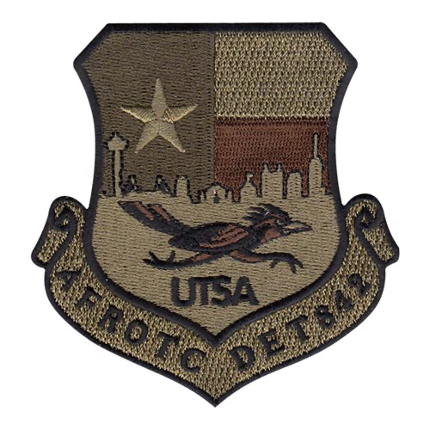

Merchandise
Item | Price
Det Polo | $30
Det Shirt (used for PT) | $20
Patch (colored or OCP brown) | $5
Stickers | $2
Coin | $10
Morale Shirt | $20
Air Force ROTC Detachment 842 • We Build Exceptional Officers • The University of Texas at San Antonio

Slide 70

Summary
What Is Booster Club
Why Join
How To Join
Officers
Merchandise
Questions
Air Force ROTC Detachment 842 • We Build Exceptional Officers • The University of Texas at San Antonio

Slide 71







Questions?
President
C/Jara
luis.jara@my.utsa.edu
Vice President
C/Olivares
ailana.olivares@my.utsa.edu
Events
C/Palafox
palafox.jazmine@my.utsa.edu
Snack
C/Acevedo
nephi.acevedo@my.utsa.edu
-
Sales
C/Schrecker
shelby.schrecker@my.utsa.edu
Photographer
C/Villamaria
orianne.villamaria@my.utsa.edu
Air Force ROTC Detachment 842 • We Build Exceptional Officers • The University of Texas at San Antonio

